Slide 1
MAKING MULTILEVEL GOVERNANCE WORK: HELPING TO OVERCOME THE DEMOCRATIC DEFICIT Webinar 4
EU Centre of Excellence
29 August 2023

Slide 3
Multilevel governance & democracy: A brief look at challenges and opportunities
Maren Klein
RMIT University

Slide 4
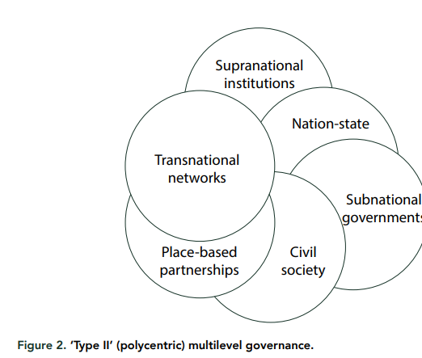
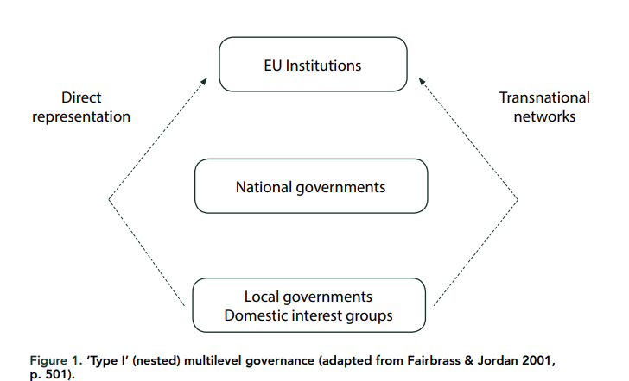
Evolution of an ‘elastic concept’ -1
…Multilevel governance, a system of continuous negotiation among nested governments at several territorial tiers–supranational, national, regional and local– … in which supranational, national, regional and local governments are enmeshed in territorially overarching policy networks (Marks, 1993)
Hooghe & Marks (2003)
Multilevel governance is the dispersion of authority to jurisdictions within and beyond national states (Hooghe, Marks, & Schakel, 2020)
Source: Bulkeley et al. (2003)

Slide 5
Evolution of an ‘elastic concept’ - 2
The concept of MLG refers to political systems in which government competences are dispersed across multiple territorial and/or function-specific jurisdictions, and in which both public and private actors – including executives of various tiers of government, bureaucrats and subject-matter experts, as well as stakeholders – are involved in policymaking … This setup results in distinctive policymaking processes that are characterized by coordination and/or joint decision-making between jurisdictions – vertically (between units at different levels), horizontally (between units at the same level) and cutting across policy fields as well as the public–private divide (Hurrelmann, 2021).

Slide 6
MLG – (un)democratic aspects
MLG systems and their distinctive modes of policymaking are, in most cases, the result of flexible and incremental institutional adaptation to functional pressures (Hooghe, Lenz and Marks, 2019), rather than the product of deliberate institutional design.
Principles of democratic legitimacy therefore tend to play a subordinate role in their emergence (Hurrelmann, 2021).

Slide 7
MLG and democratic legitimacy
1 Input legitimacy
refers to citizens’ opportunities to participate in political decision-making either directly or indirectly
2 Output legitimacy
highlights the substantive quality of decisions to ‘effectively promote the common welfare of the constituency in question’
3 Throughput legitimacy
a procedural criterion concerned with the quality of governance processes, as judged by the accountability of the policy-makers and the transparency, inclusiveness and openness of governance processes.

Slide 8
Governments are facing increasingly complex policy challenges, ranging from climate change, demographic pressures, rising inequalities and discontent, to the global health crisis that countries are presently confronting. Successful responses require more integrated approaches to policy making at all levels of government, so that economic, social and environmental actions reinforce each other rather than compete. They also require effective coordination across levels of government to manage shared responsibilities, mutual dependence and common challenges.

Slide 9
Twenty years of multi-level governance: ‘Where Does It Come From? What Is It? Where Is It Going?’ (Stephenson, 2013)

Slide 10
Thank you.

