Slide 1

VICYSAVER
A multi-purpose
tool kit for
digitalꢀsafety

Slide 2
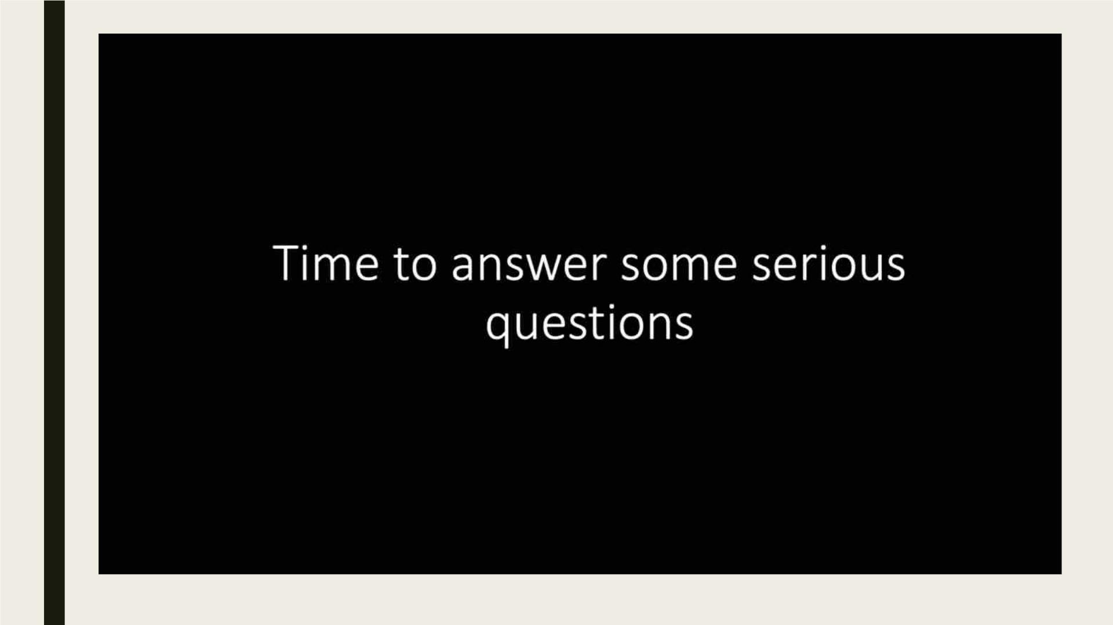
RMIT Classification: Trusted

Slide 3

RMIT Classification: Trusted
TEAM F5
Achintya
Master of Data Science
Anirudhda
Master of Data Science
Pavani
Master of Cyber Securityꢀ
ꢀ ꢀ ꢀLakshmi Priya
Master of Data Science
Thyagarajan
Master of Data Science

Slide 4
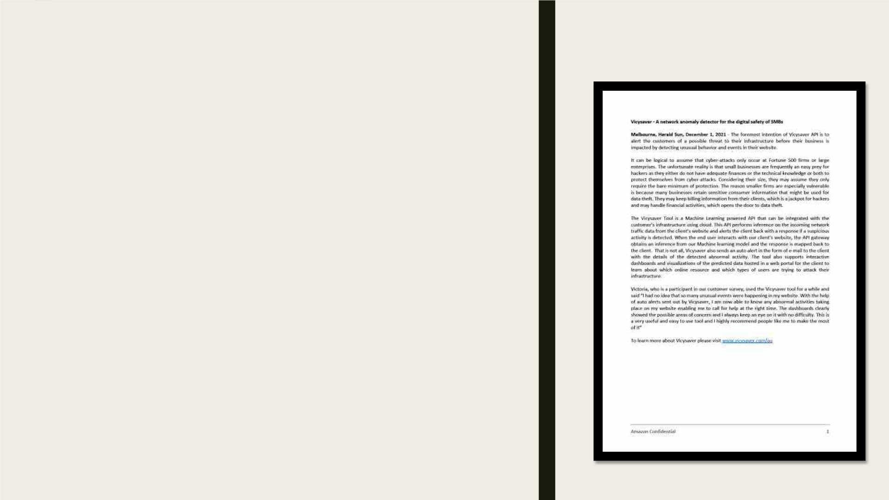
PRFAQ
WB APPROACH
• Identifying the Customer.
• Identifying Customer pain points
• Identifying Customer problem/opportunity
• Generating Press Release

Slide 5
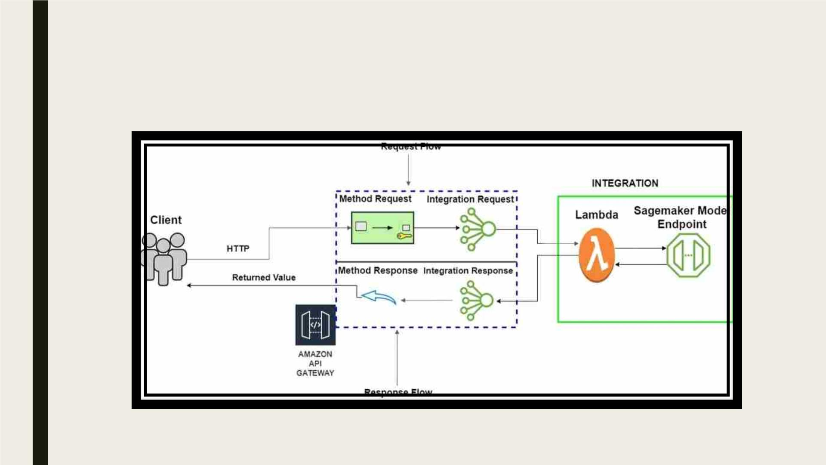
RMIT Classification: Trusted
ARCHITECTURE

Slide 6

RMIT Classification: Trusted
Why Machine Learning?
ꢀ ꢀ ꢀ ꢀ Why Ip insights?
• Ability to learn from the data
• Enhanced detection speed
• Learns usage patterns for IPv4 addresses
• Detects anomalous Ip addresses

Slide 7
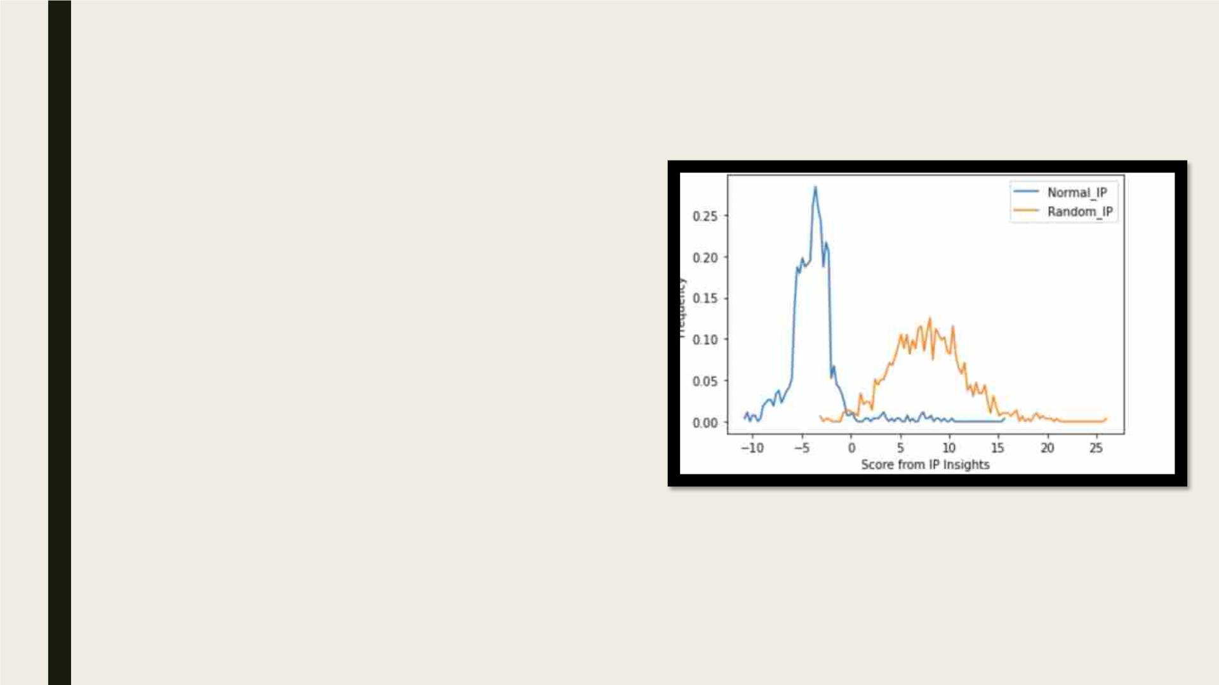
RMIT Classification: Trusted
WORKING OF IP INSIGHTS
• Captures associations between online
resources (account IDs/hostnames
and IPv4 addresses
• IPv4 or IP addresses: unique
addresses of digital devices on
internet
• Assign scores based on compatibility
between hostnames and IP addresses
• Threshold: Identification of score
value from which suspicious behavior
starts
• Score above threshold considered
anomalous; triggers MFA (Multi Factor
Authentication)

Slide 8
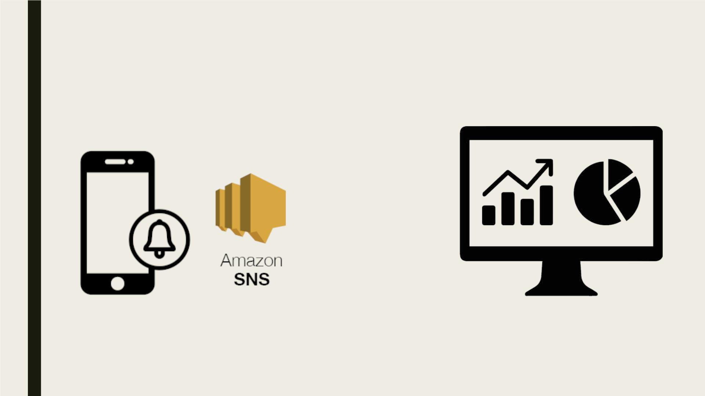
RMIT Classification: Trusted
FUTURE ENHANCEMENTS
Notification Service
Dashboard

Slide 9

Classification: Trusted
Helps
businesses
act
Detects
suspicious
login
KEEP CALM,
VICYSAVER
IS HERE
beforehand
attempts
Uses a
machine
learning
model
Provide alerts
Can train
numerous
web logs
Scalable

Slide 10

DEMO

Slide 11

RMIT Classification: Trusted
ACKNOWLEDGEMENTS

Slide 12

THANK YOU

Slide 13

QUESTIONS
PLEASE !

