Slide 1


Security99
RMIT Cloud Innovation Challenge (CIC)
Team 2
Prasant Shanmugasekar
Neha Thakur
Deeksha Kini
Ronit Pradhan
Holly Wong
Date: 2021.10.14

Slide 2

CONTENTS
1
Our Team
Team introduction, roles and responsibilities
2
Sponsor & Challenge
Introduction to the sponsor, problem statement
3
Design Thinking Phase
Design process, takeaway
4
Solution Build Phase
Our solution, steps involved, architecture diagram

Slide 3
CONTENTS
5
Demo
6
Future Scope
7
Acknowledgement
8
Q&A

Slide 4

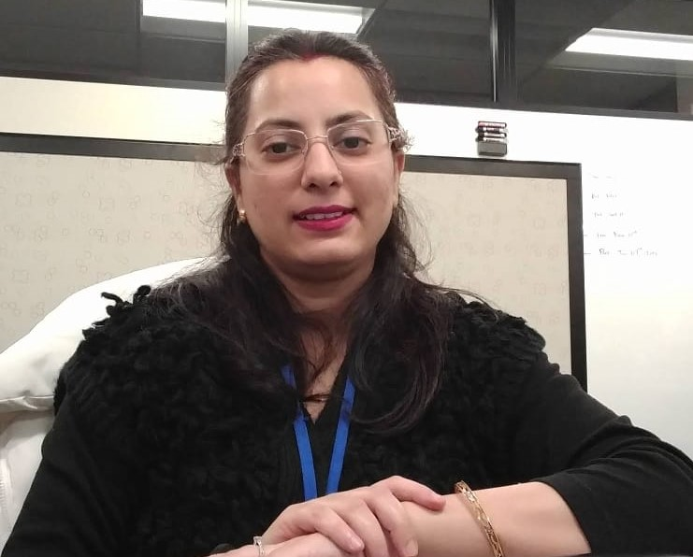



01
Our Team
Prasant Shanmugasekar
Neha
Thakur
Deeksha
Kini
Ronit
Pradhan
Holly
Wong
1
2
3
4
5
Team Leader
Cyber Security
Cyber Security
Data Science
Cyber Security
Digital Media Design

Slide 5
Our Sponsor

Slide 6

02
Our Sponsor
1
Cloud service from Amazon
Provides services in the form of building blocks which can be used to create and deploy any type of application in the cloud
2
Offers database storage, content delivery and other cloud resources to customers
Allows users to build & sophisticated applications at a scalable through leveraging AWS cloud products and solutions
3
Enables the use of multiple cloud services
Including the operating system, programming language, web application platform, database, and any other services you need

Slide 7
02
Problem Statement
?
“How might we increase the capability of ANZ SMBs to better respond to cyber-attacks?”

Slide 8
Design Thinking Phase

Slide 9

03
Working Backward Workshop
Persona
Crazy 8s
Ideal User Experience
Major Benefits
Press Release
Visuals

Slide 10
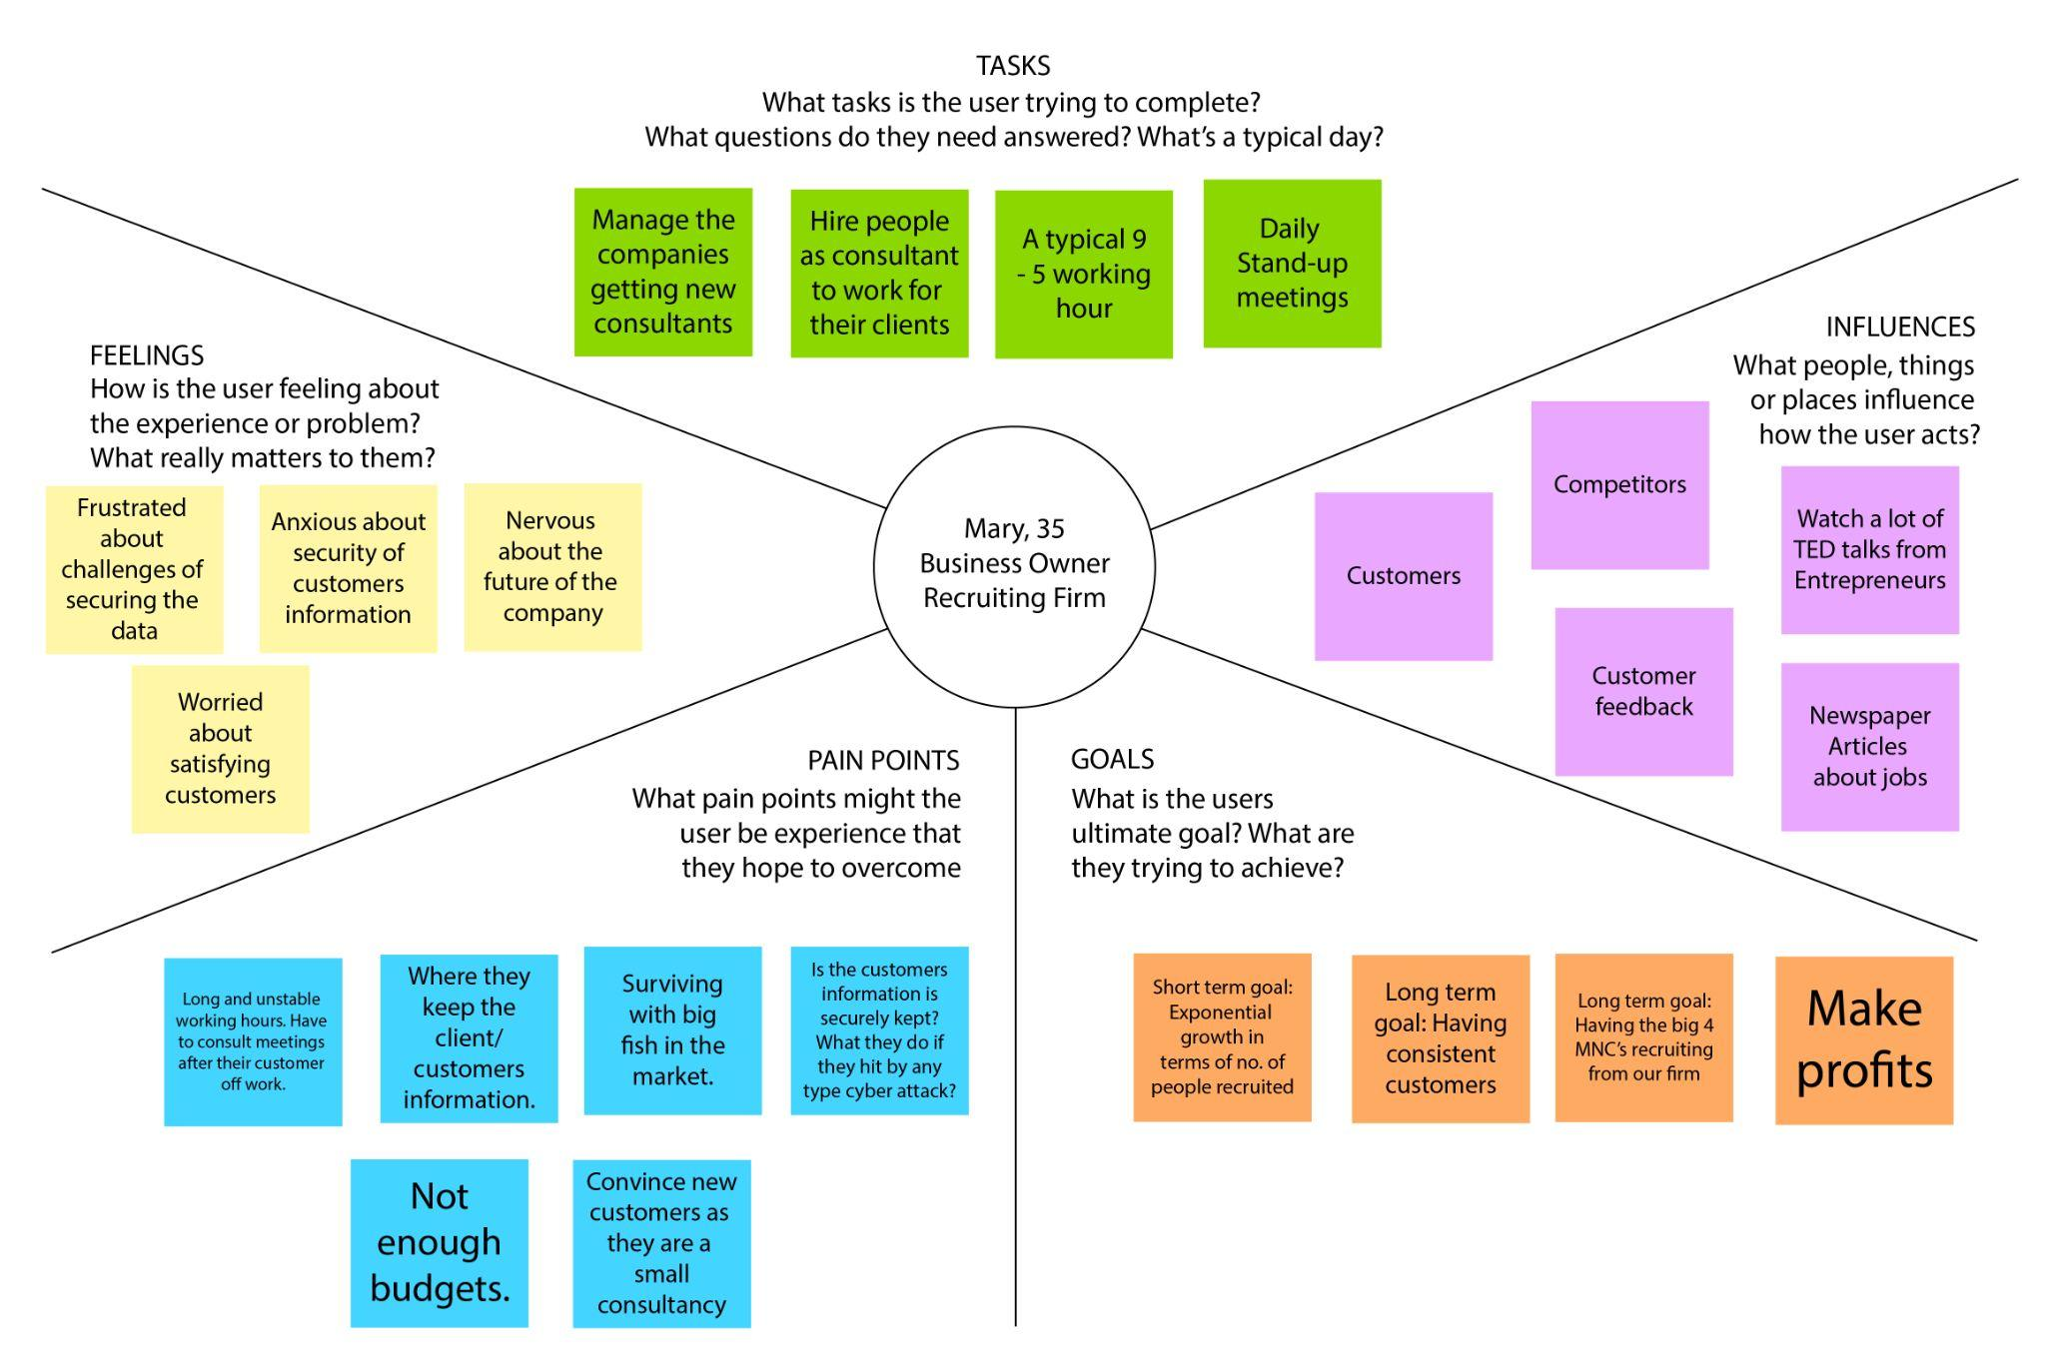
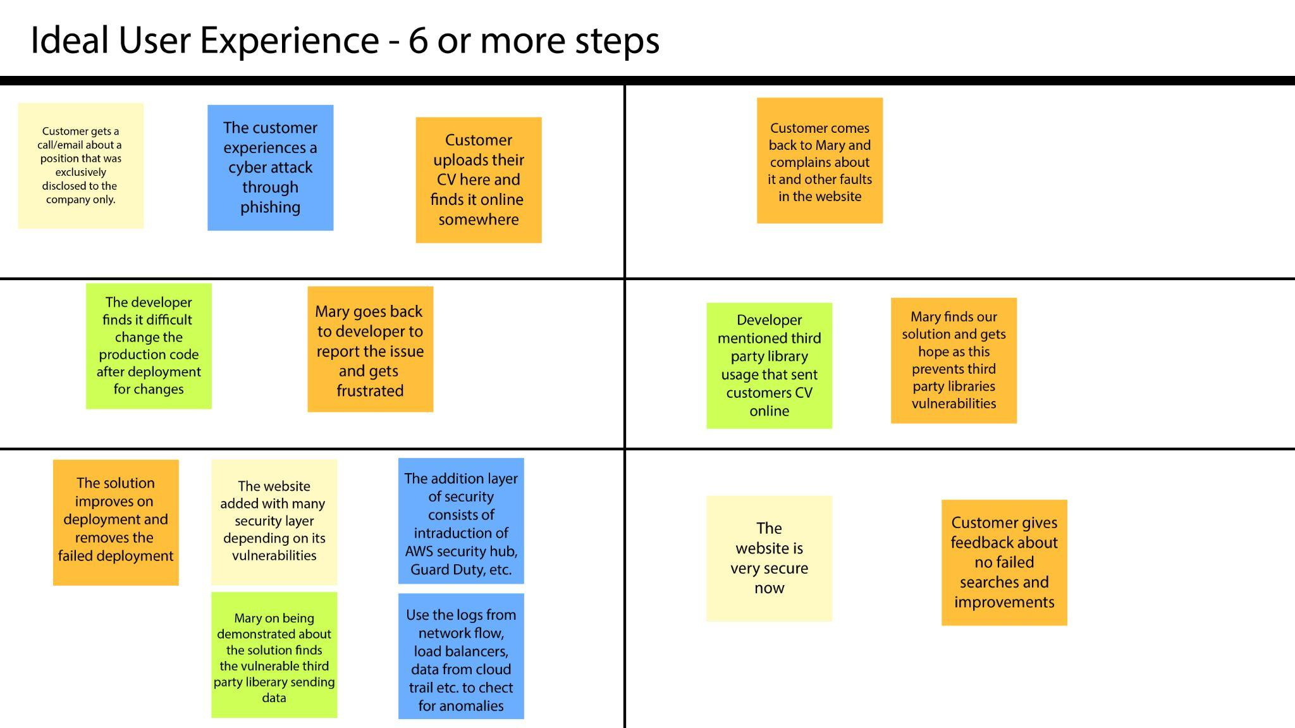
03
Working Backward Workshop
Persona
Ideal User Experience

Slide 11
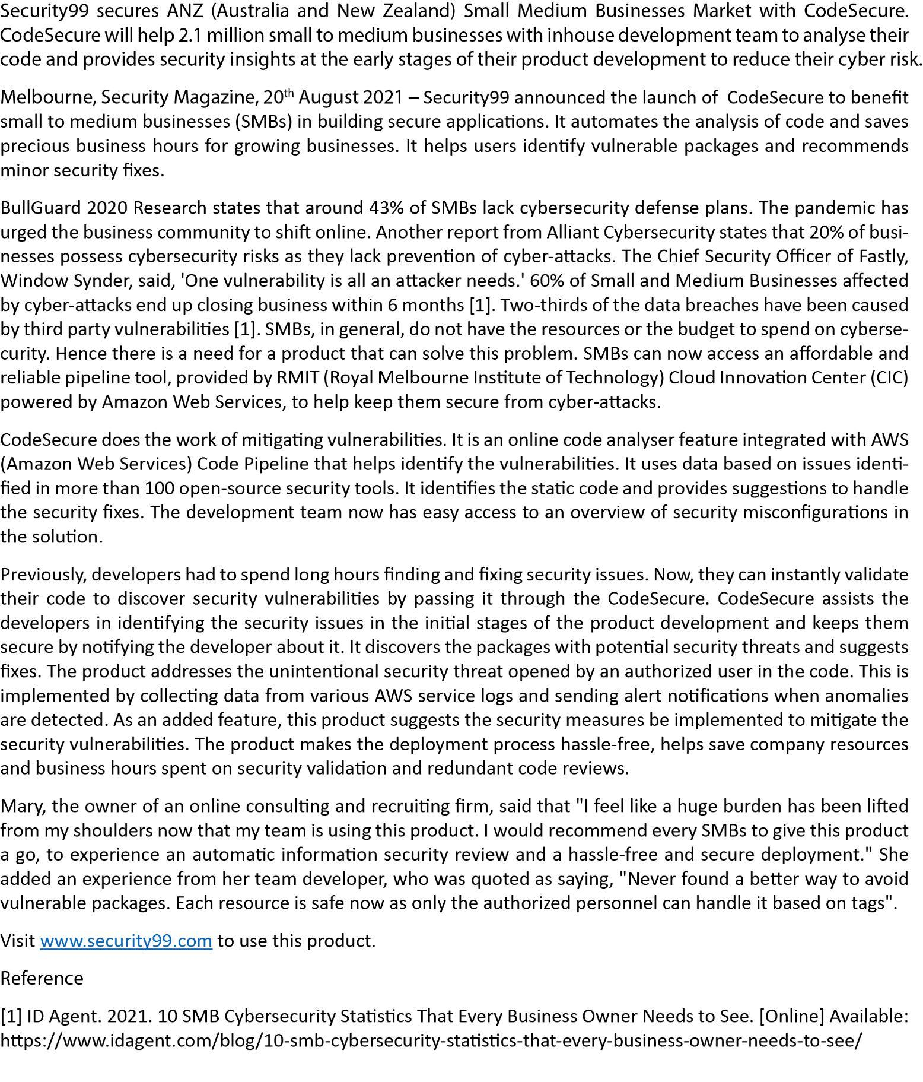
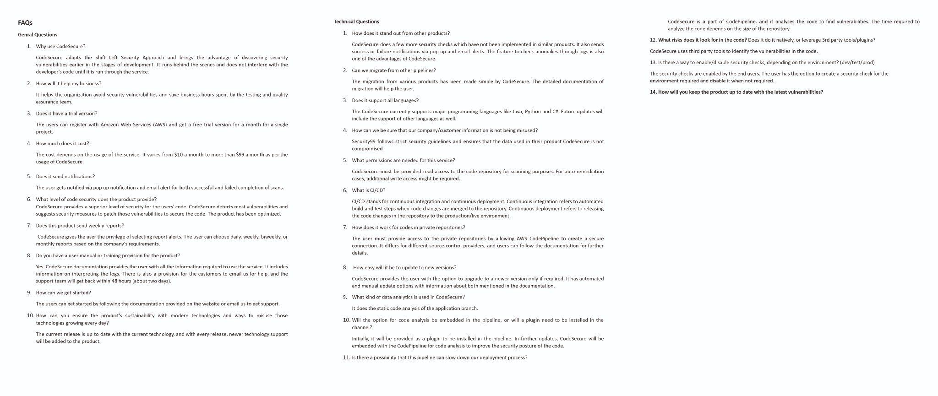
03
Working Backward Workshop
Press Release
FAQ

Slide 12
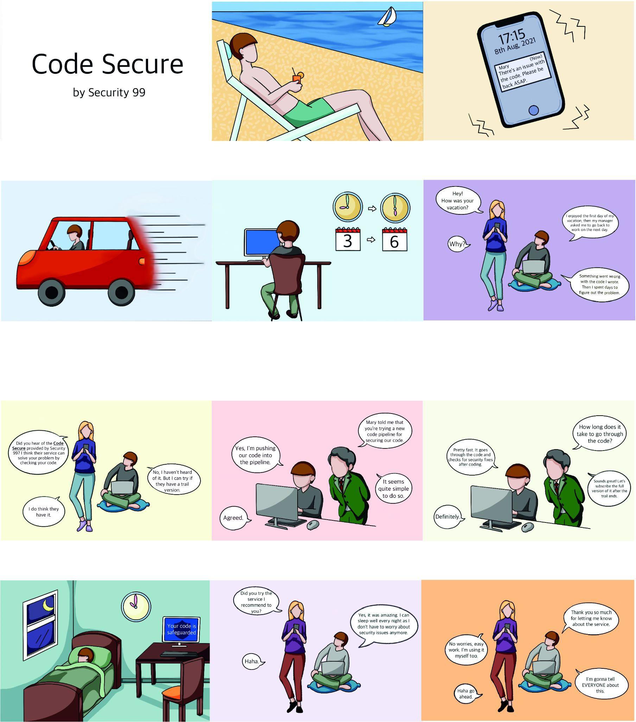
03
Working Backward Workshop
Storyboard

Slide 13
03
Working Backward Workshop
Storyboard

Slide 14
Solution Build Phase

Slide 15
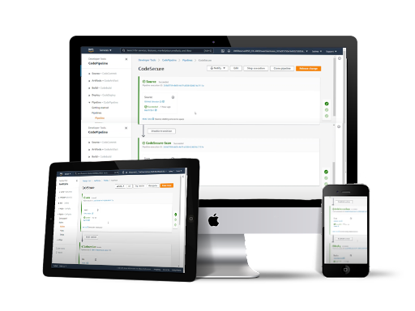

04
Gist of Solution
CODE SECURE
Easy to use
Effective and rich with knowledge
Low cost and secure

Slide 16


04
Steps Involved
Customer Input/Set up
01
Provide Repository Link and Organisation Key from Sonar Cloud
Steps Involved
Scanning and Reporting
02
Cloning, Scanning and Creation of Report
03
Display Results
View Results

Slide 17



04
AWS Services
Elastic Container Registry and Elastic Container Service
01
AWS Service
Storing of Docker Image and Running of Docker Image
02
Code Pipeline
Adding of ECS Stage to Pipeline
03
S3 Bucket / Fargate
Store results

Slide 18
04
Solution Build Phase
Architecture Diagram

Slide 19
Demo

Slide 20
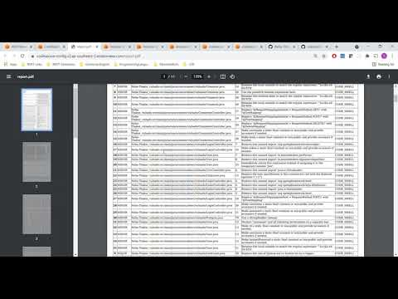
05
Demo

Slide 21
Future Scope

Slide 22



06
Future Scope
In the future we will make it dynamic.
More security tools
Creation of Dashboard
Remove manual approval step
To have refined results
Containerizing the dash application
It will automatically be deployed

Slide 23
Acknowledgement

Slide 24


07
Acknowledgement

Slide 25
Q&A

Slide 26
Thank You

