Slide 1
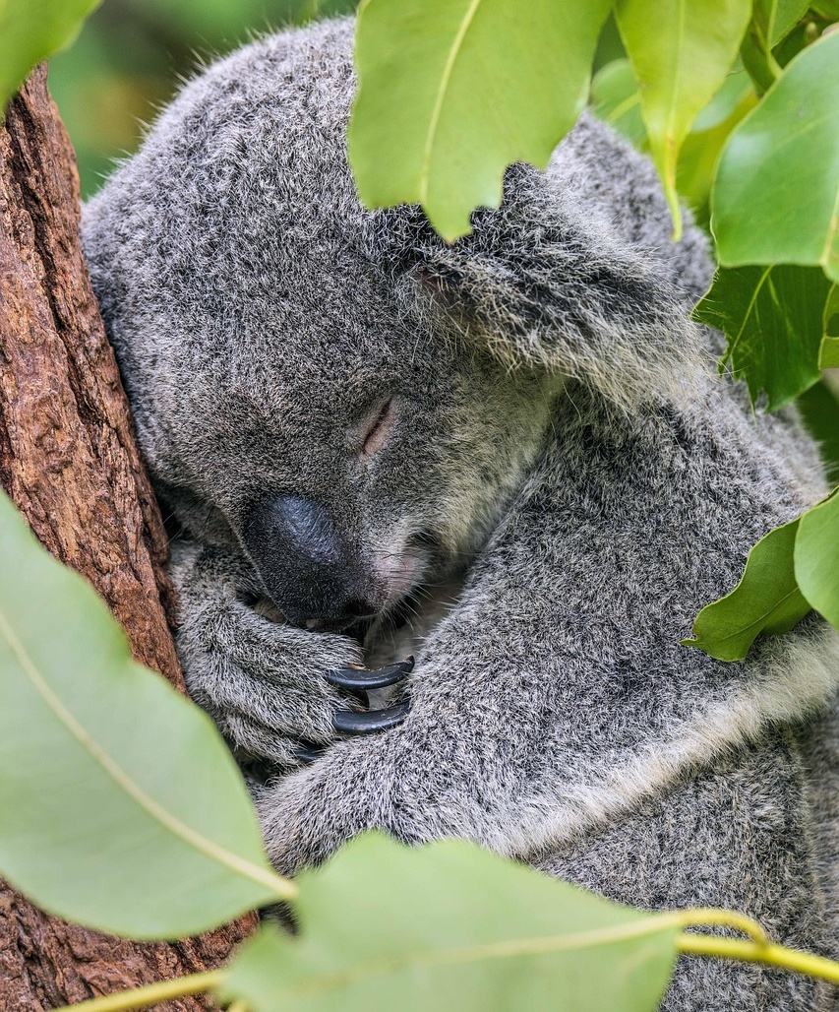
Celebrating
Sustainability Week 2026

Slide 2
RMIT promotes the waste hierarchy of ‘Reduce, Reuse, Recycle’ to minimise our impact on the environment.
"Too often we focus on only recycling our waste, without firstly considering if we can eliminate the waste or limit the amount of waste produced by reusing items.”
Source: Circular economy and recycling
Artwork “Sentient by Hollie Johnson
Hollie is a Gunaikurnai and Monero Ngarigo woman from Gippsland who graduated from RMIT with a BA in Photography in 2016.

Slide 3
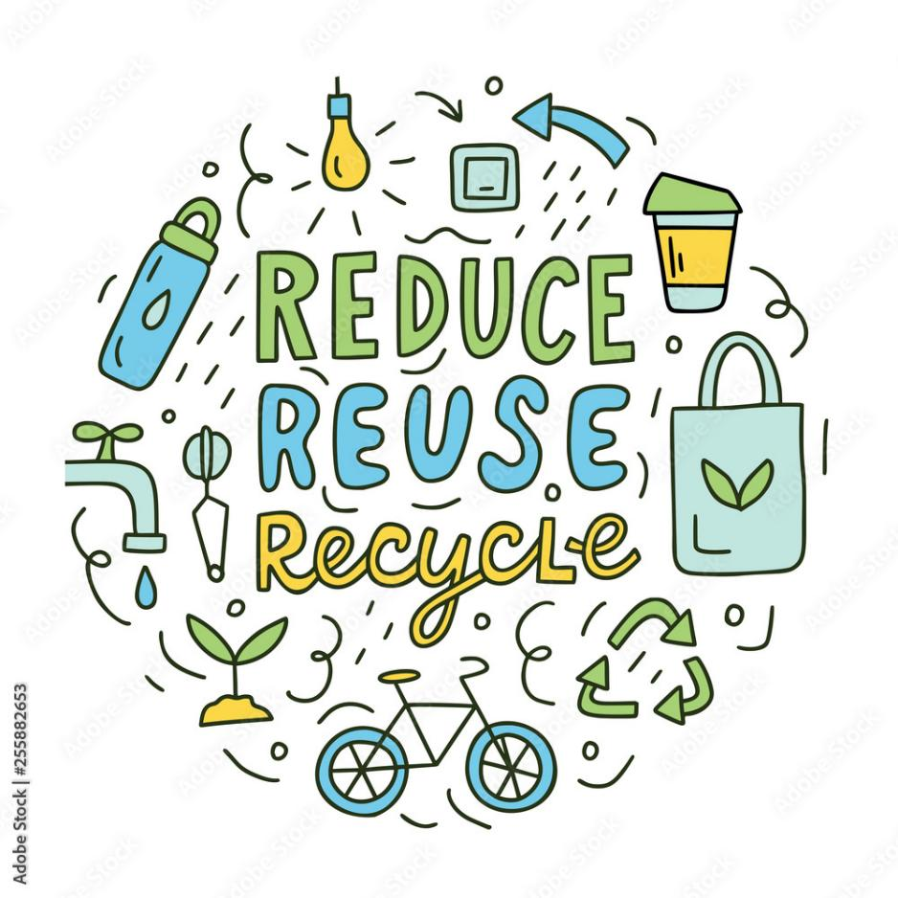
Reduce.
Reduce the amount of waste you create.
Tip:
Buy and use just what you need and avoid single use items.

Slide 4
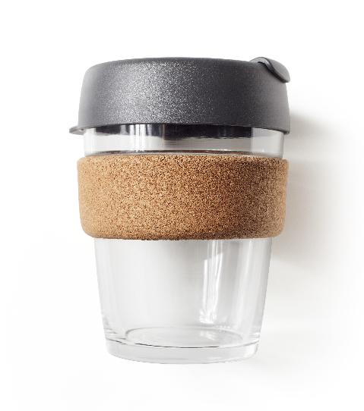
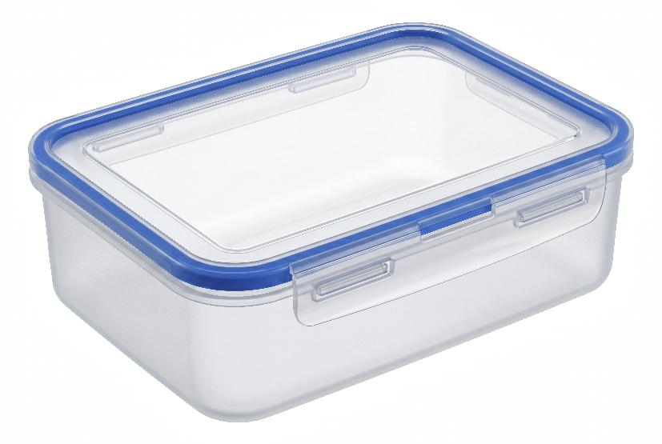
Reuse.
Reuse what you already have.
Tip:
Bring a reusable cup or container for takeaway.

Slide 5
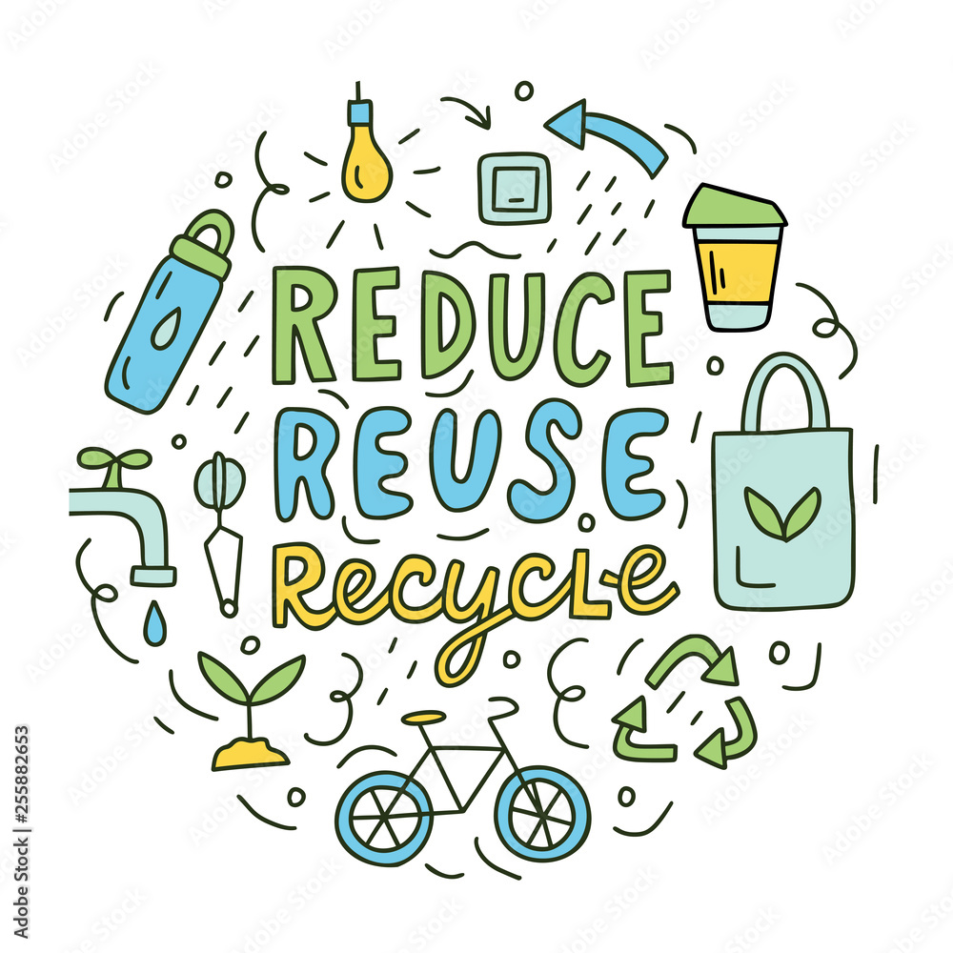
Recycle.
Recycle waste where possible, to turn it into something useful.
Tip:
Only put what can be recycled into the yellow bin.
Incorrect items contaminate the bin, which could mean items are sent to landfill.

Slide 6

RMIT uses a three bin system:
Mixed recycling (Yellow bin)
Aluminium and steel cans
Glass bottles and jars
Hard plastic bottles
Remove lids and empty containers

Slide 7

RMIT uses a three bin system:
Paper/cardboard (Blue bin)
White and coloured paper
Newspapers, magazines and brochures
Clean cardboard (flattened)
Envelopes (including window)

Slide 8
RMIT uses a three bin system: Landfill (Red bin)
Plastic lined packaging (cartons and Tetra Pak)
Coffee cups and lids
Plastic takeaway cups and straws
Compostable packaging and cutlery
Soft-plastics
Bottle tops and lids
Paper towels, tissues and napkins

Slide 9
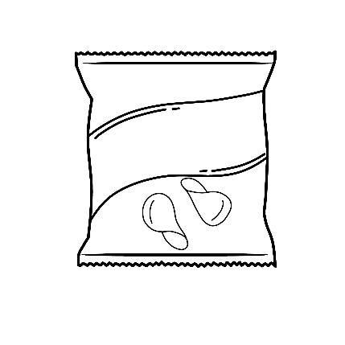


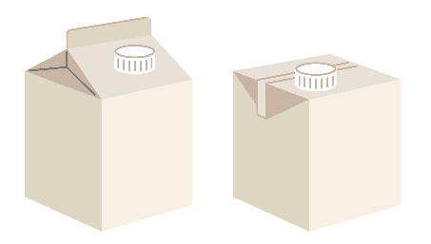
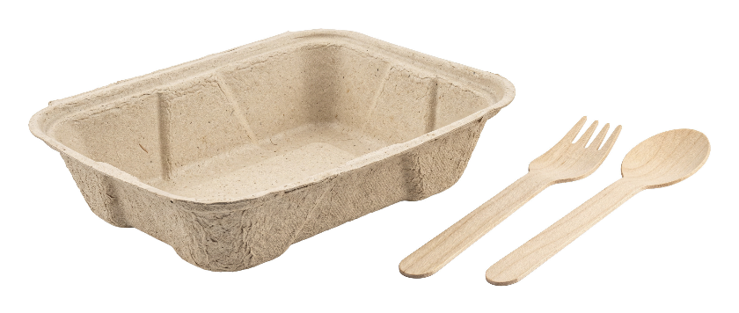
Remember, at RMIT...
Soft plastics
Takeaway cups, lids and straws
Tissues, paper towels and napkins
Compostable packaging and cutlery like BioPak
Plastic lined packaging (milk cartons and Tetra Pak)
Go in the red landfill bin (not the recycling bins).
This is based on RMIT’s waste contractor guidelines.
Your Local Council recycling guidelines may differ.

Slide 10
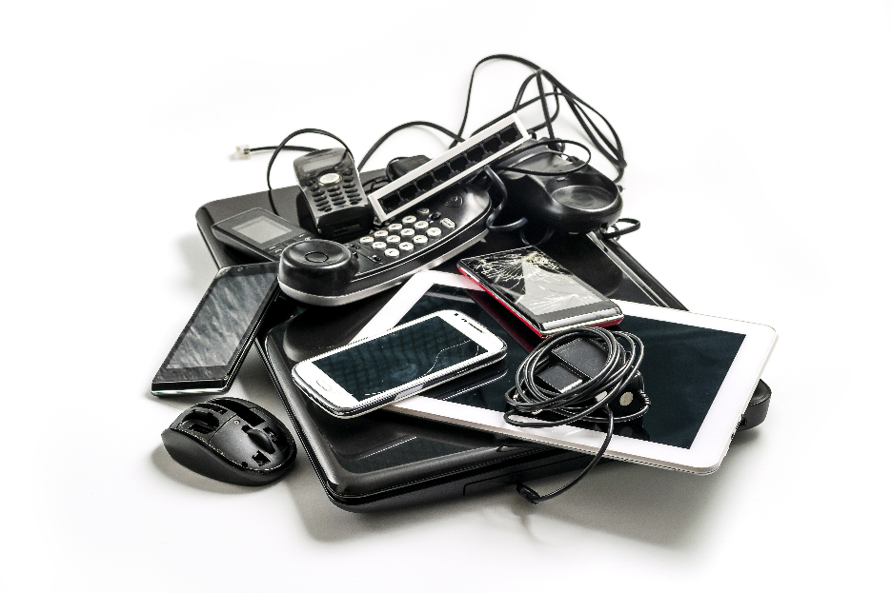
Remember…
E-waste (things with a plug, battery or cord) and batteries must be kept out of bins.
E-waste is banned from landfill and must be recycled at a drop-off point.
Visit an RMIT TechBAR to learn about options.

Slide 11

Find out more
Circular economy and recycling at RMIT.
Check out the Library's books and other resources about sustainability.
Small actions can have a big impact.

