Slide 1

#RMITPride
rmit.edu.au/prideweek

Slide 2
Pride Week 2022
Pride Trivia Pack
#RMITPride
rmit.edu.au/prideweek

Slide 3
How do I join in?
Learn more about the LGBTIQA+ community while celebrating RMIT Pride Week!
From here, it's easy – if you're the Quizmaster:
Create a calendar event, invite your group and add a Teams meeting
During the meeting, share your screen with the other participants
If you're a player:
Open a blank document or sheet of paper to record your answers.
#RMITPride
rmit.edu.au/prideweek

Slide 4
What are the rules?
Usual trivia rules apply!
There are six categories
Record your answers
Share your scores!
All categories feature LGBTIQA+ knowledge, history and public figures.
These are: Flags and terminology; History; Pop Culture; Political; Sport; and Art and fashion.
Each player records their individual answers.
Or, if playing with a large group, break into teams and allocate a person to record the answers.
The answers are listed at the end with details on how much they are each worth.
Rank your points and see how well you did!
#RMITPride
rmit.edu.au/prideweek

Slide 5
Round 1
Flags and terminology
#RMITPride
rmit.edu.au/prideweek

Slide 6





Question 1
Identify these flags (1 point per correct answer)
#RMITPride
rmit.edu.au/prideweek

Slide 7
Question 2
What is the umbrella term used to describe genders that sit outside the binary of woman and man? (1 point)
Question 3
What do you call the assumption or belief that heterosexuality is the preferred or normal mode of sexual orientation? (1 point)
Question 4
The Asexual Pride flag is composed of what colour stripes? (1 point)
Question 5
If gender dysphoria is the distress or unease sometimes experienced from being misgendered, what term is commonly used to describe the opposite experience? (1 point)
A. Gender glee B. Gender euphoria C. Gender expression D. Gender hooray
#RMITPride
rmit.edu.au/prideweek

Slide 8
Round 2
Pop Culture
#RMITPride
rmit.edu.au/prideweek

Slide 9
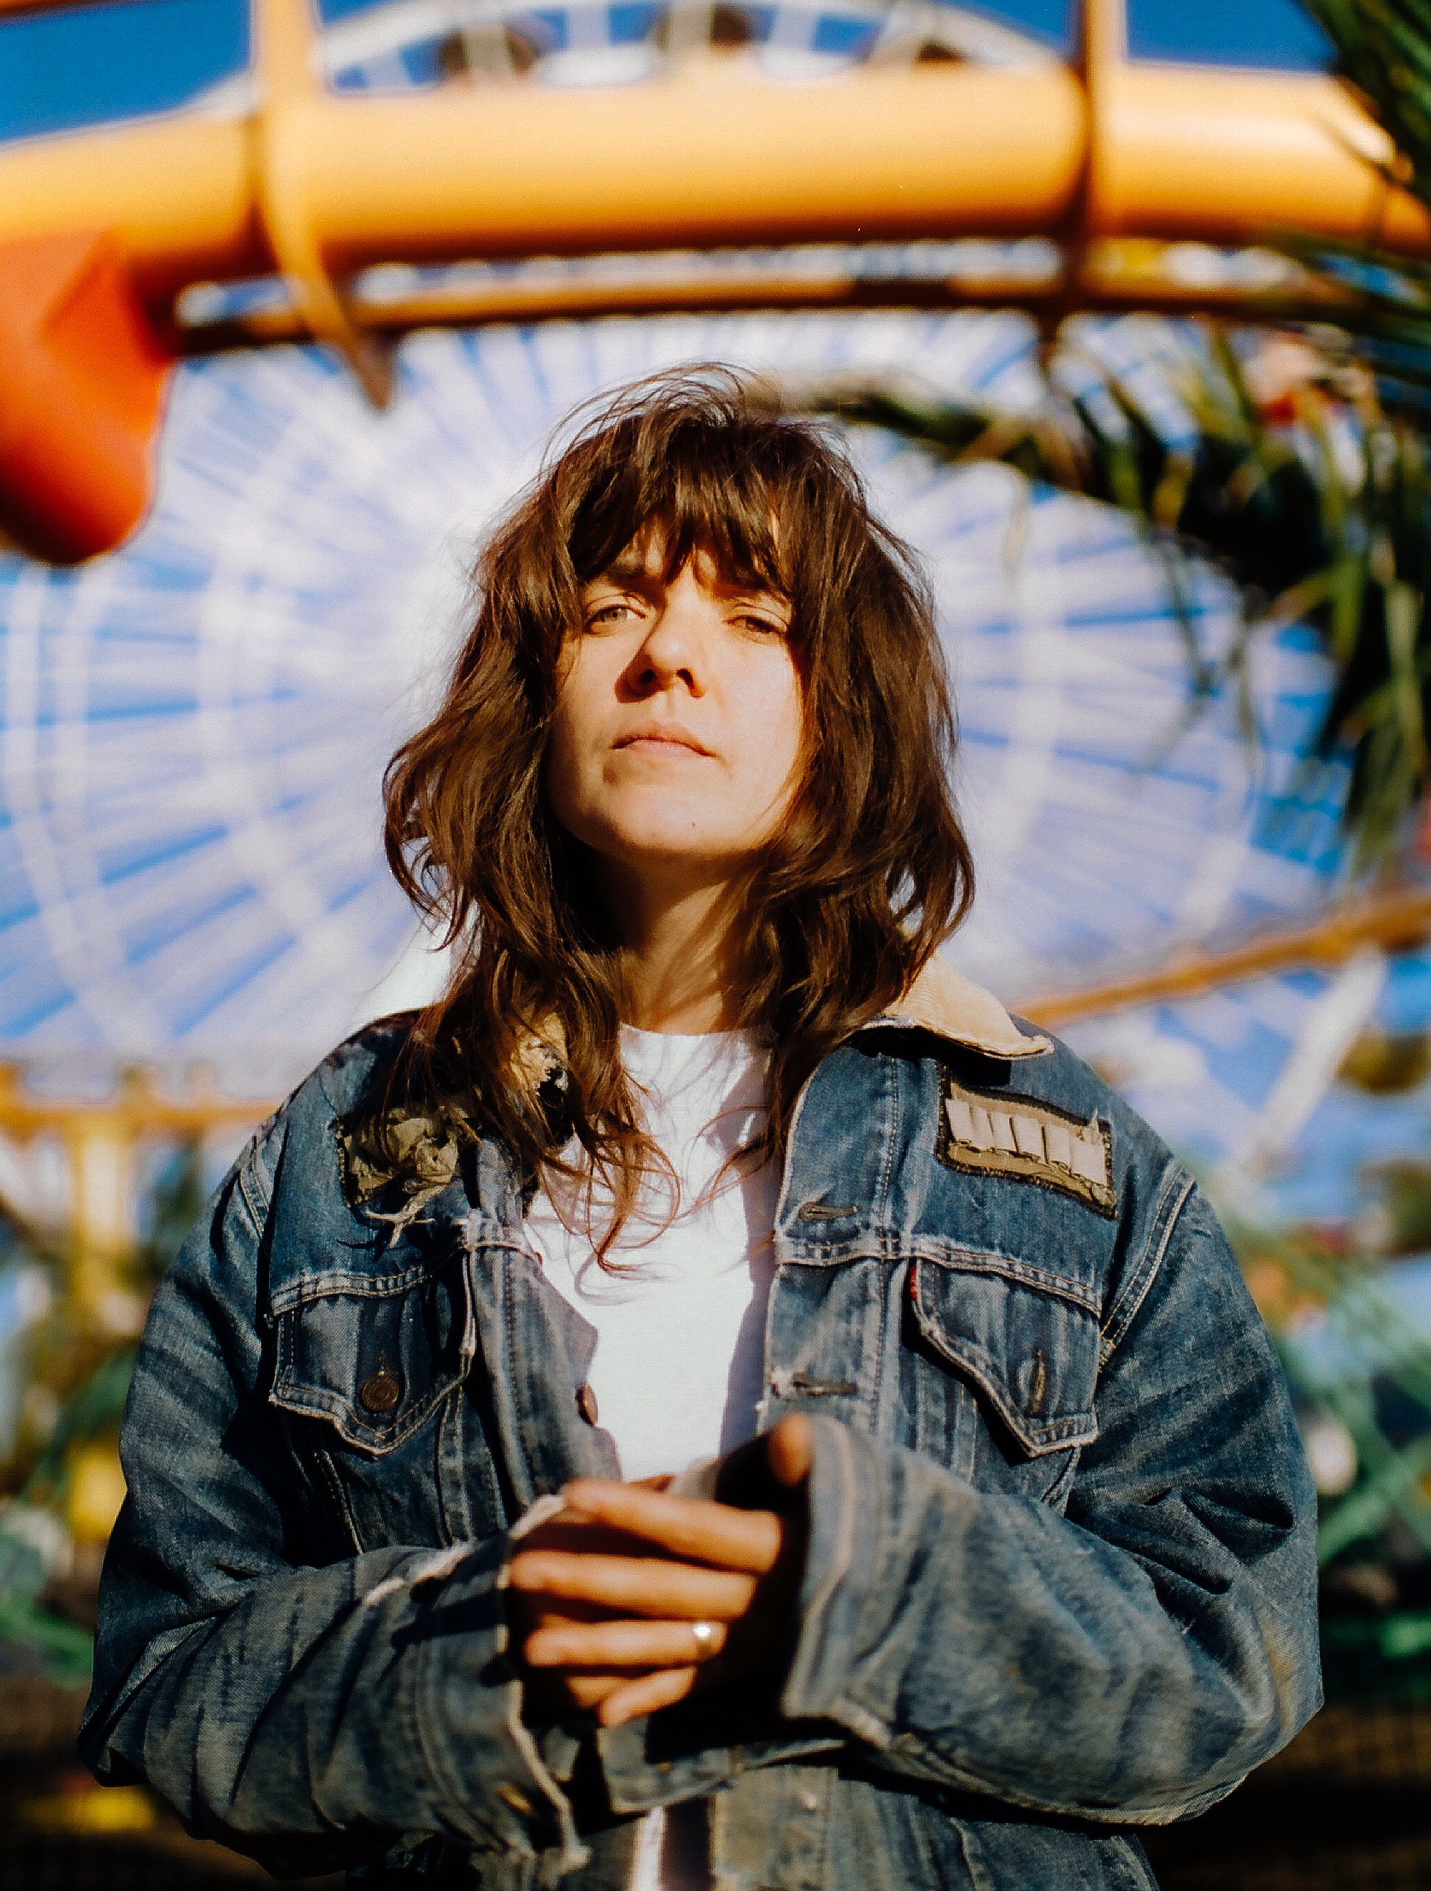
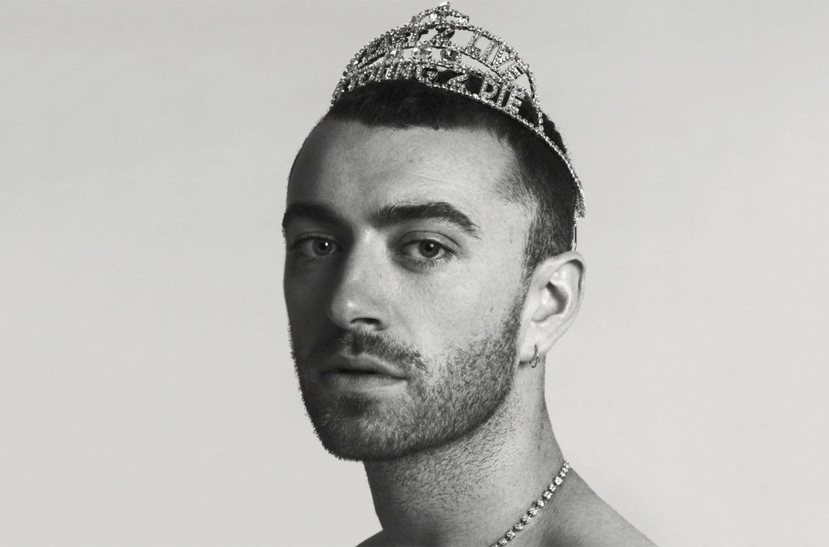
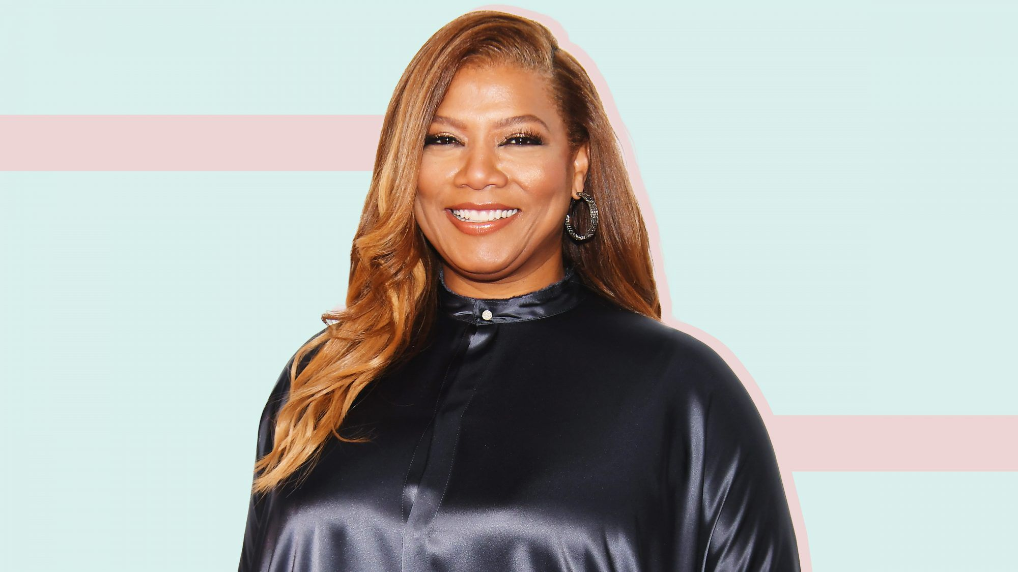
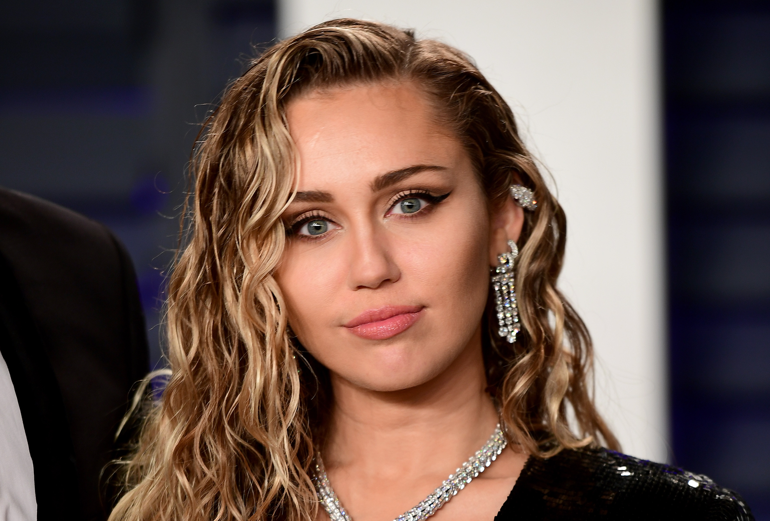
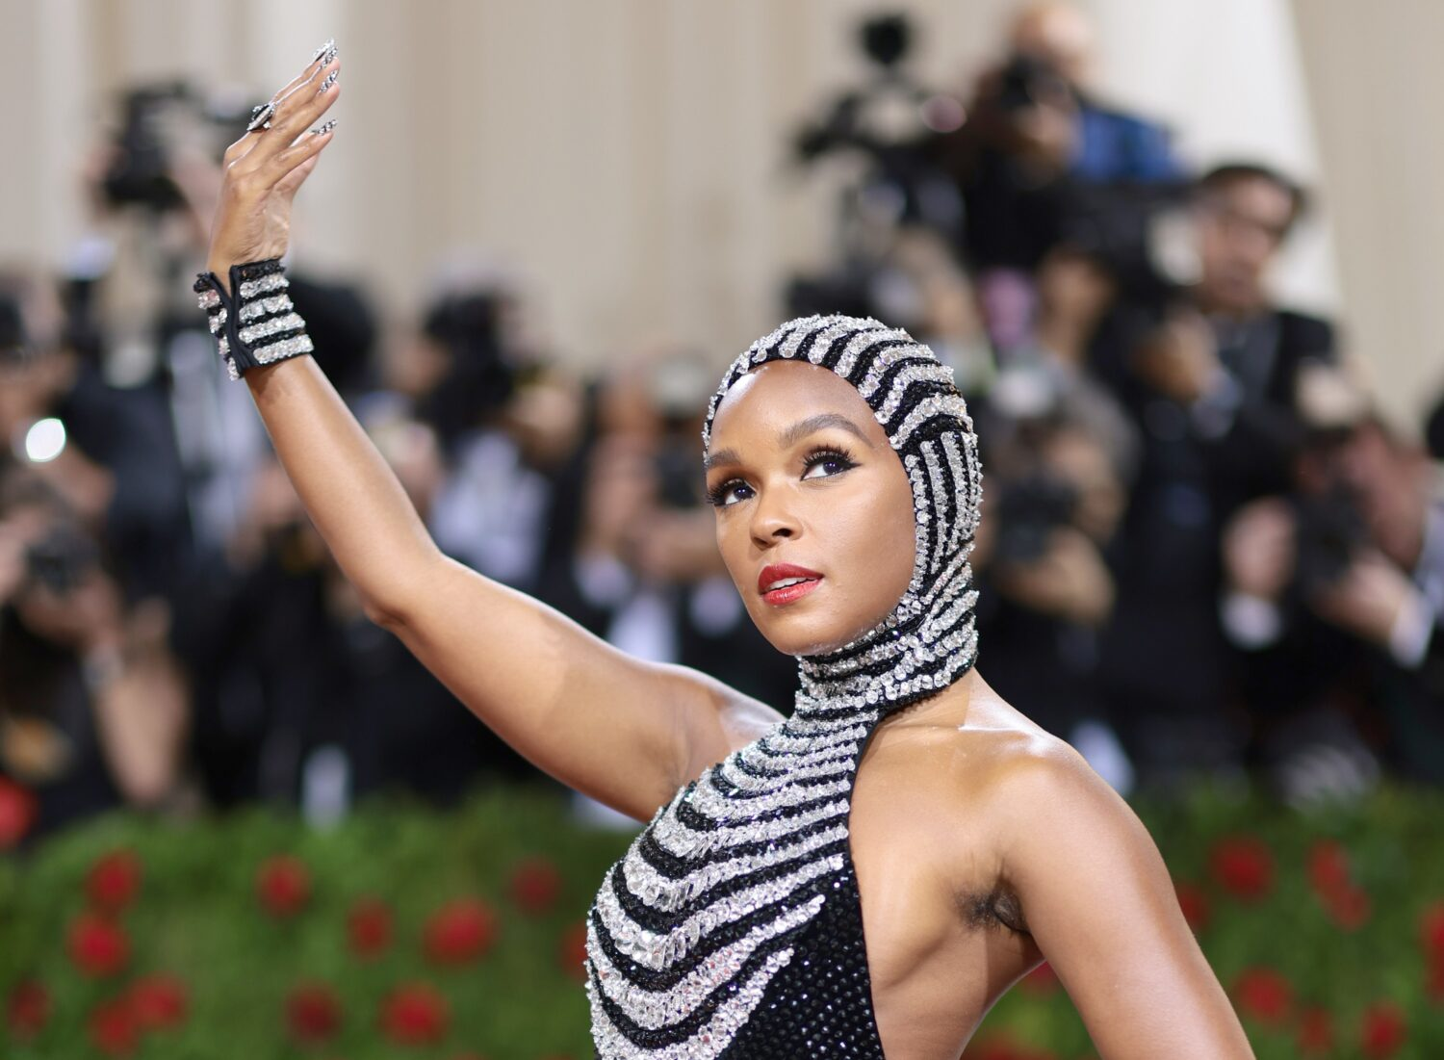
Question 6
Guess the famous musicians (1 point per correct answer)

Slide 10
Question 7
Who was the first-ever winner of RuPaul's Drag Race Down Under? (1 point)
Question 8
Who played Freddie Mercury, the lead singer of the British rock band Queen, in the recent music biopic? (1 point)
Question 9
What documentary depicted New York City's drag ball life at the heigh of the AIDS crisis? (1 point)
Question 10
Which TV show centers on two older women who become best friends after their husbands leave them to be together? (1 point)
#RMITPride
rmit.edu.au/prideweek

Slide 11
Round 3
History
#RMITPride
rmit.edu.au/prideweek

Slide 12
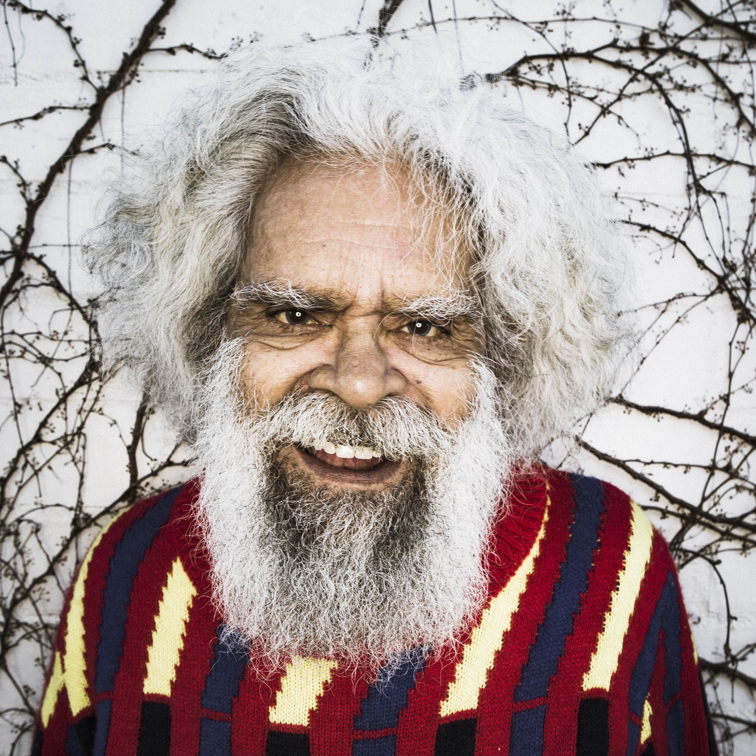
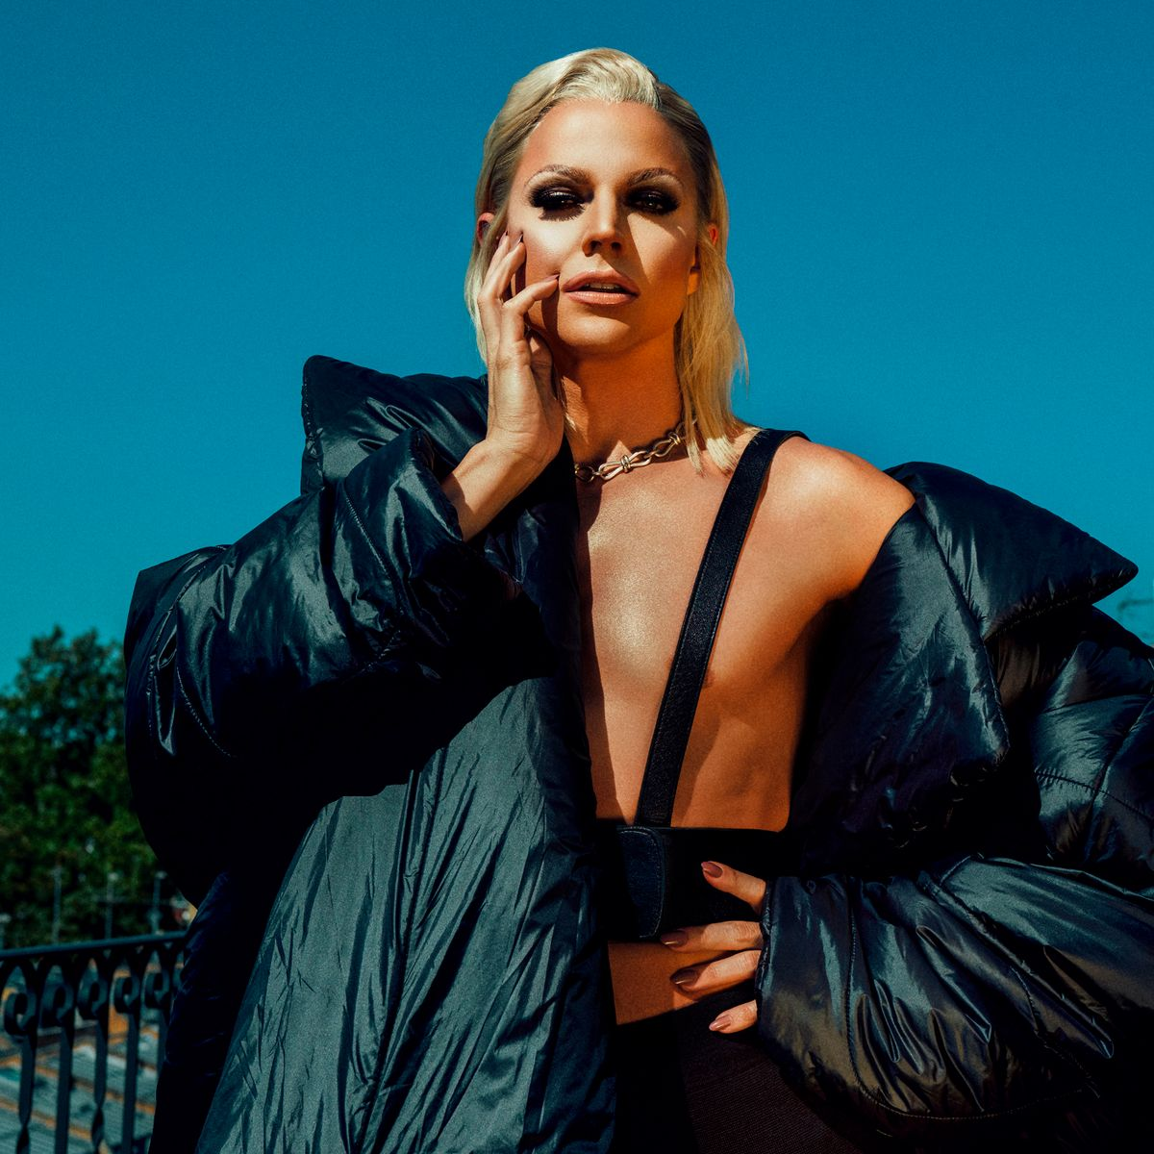
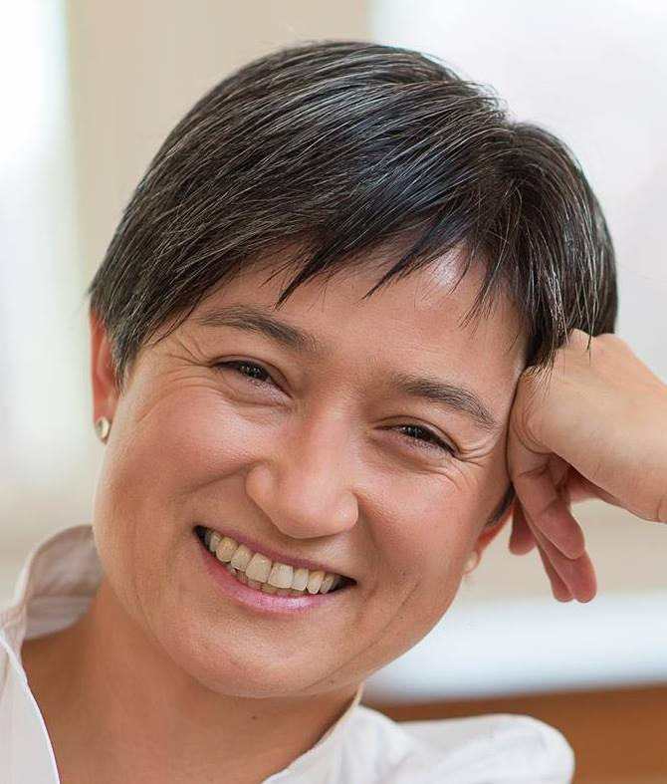
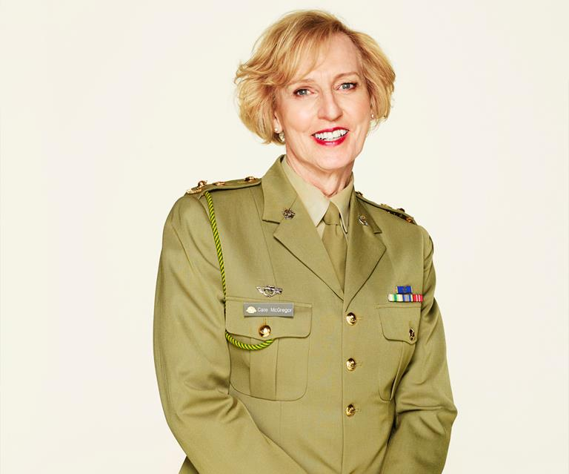
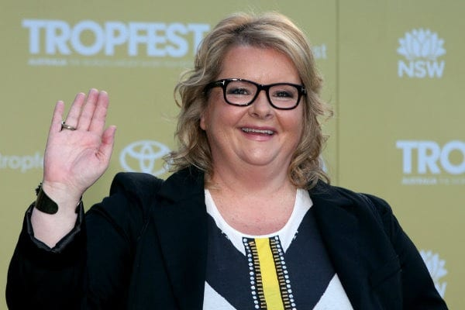
Question 11
Name these Australian figures (1 point per correct answer)

Slide 13
Question 12
The Stonewall riots took place in June of what year? (1 point)
Question 13
Who established Mardi Gras in Australia? (1 point)
Question 14
What was the name of the famous queer Australian bushranger? (1 point)
Question 15
The word 'Lesbian' is derived from which Greek Island? (1 point)
#RMITPride
rmit.edu.au/prideweek

Slide 14
Round 4
Political
#RMITPride
rmit.edu.au/prideweek

Slide 15





What year was same-sex marriage legalised in these countries? (1 point per correct answer)
Question 16
SPAIN
FRANCE
COLUMBIA
ECUADOR
AUSTRALIA

Slide 16
Question 17
Which year did Premier Daniel Andrews issue a formal apology for the state's history of anti-gay laws? (1 point)
Question 18
South Australia was the first Australian state to decriminalise male homosexuality in 1975, who was the last to do so? (1 point)
Question 19
When did the World Health Organisation declassify homosexuality as a 'mental disorder'? (1 point)
Question 20
When was the red ribbon (the solidarity symbol for people living with HIV/AIDS) introduced? (1 point)
#RMITPride
rmit.edu.au/prideweek

Slide 17
Round 5
Sport
#RMITPride
rmit.edu.au/prideweek

Slide 18
Question 21
Match the athlete with their sport (1 point per correct answer)
Athlete | Sport
Leo Baker | Rugby
Hannah Mouncey | Wrestling
Mercedes Martinez | AFL
Jason Ball | Skateboarder
Ian Roberts | Football / Soccer
Megan Rapinoe | AFL
#RMITPride
rmit.edu.au/prideweek

Slide 19
Question 22
Who am I?
I was born 22 November 1943 in Long Beach, California, and have a sibling who is also a professional sportsperson
At the age of 11, I switched from softball to tennis because my parents suggested I find a more 'ladylike' sport
I'm a strong advocate for gender equality and have been a pioneer for equality and social justice, especially in my sport.
I am a former world No.1 ranked player and have won 39 major titles.
The 2017 film Battle of the Sexes, starring Emma Stone, is about my life.
#RMITPride
rmit.edu.au/prideweek

Slide 20
Round 6
Art & fashion
#RMITPride
rmit.edu.au/prideweek

Slide 21
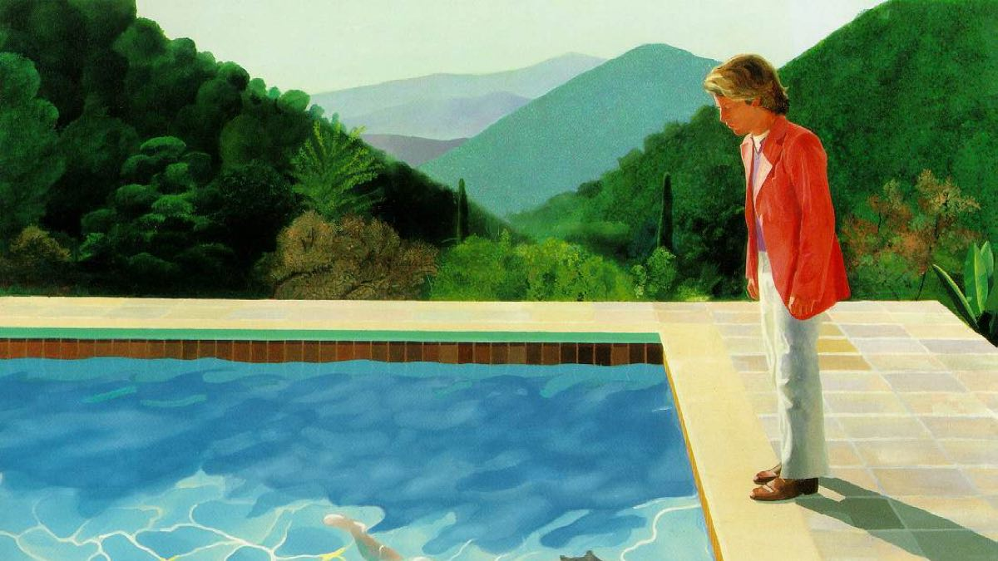
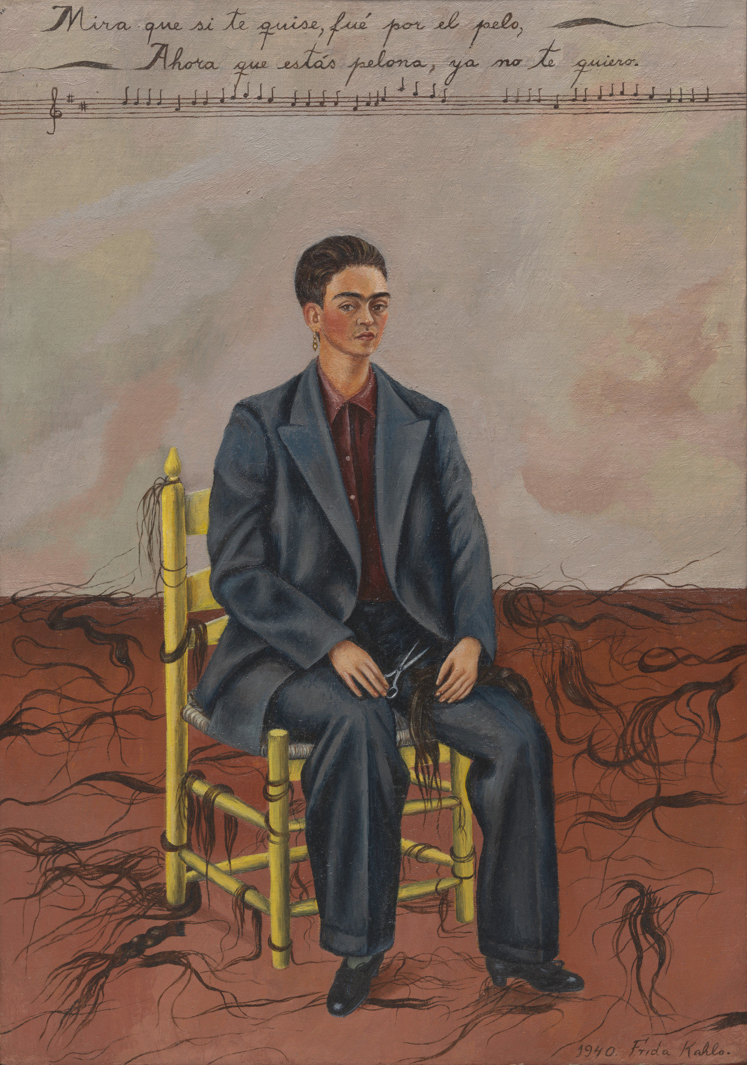
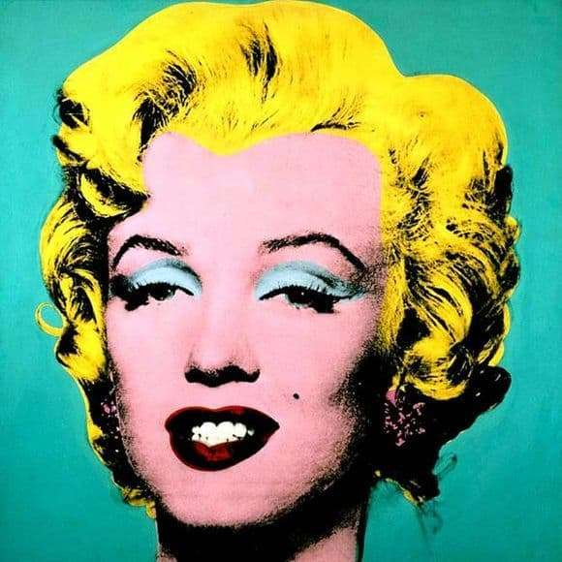
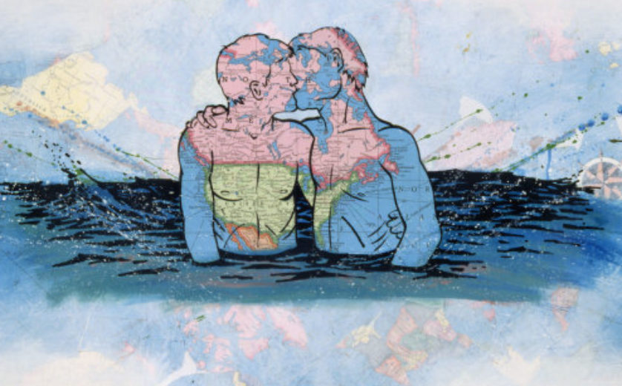
Question 23
Who created these classic artworks? (1 point per correct answer)
#RMITPride
rmit.edu.au/prideweek

Slide 22
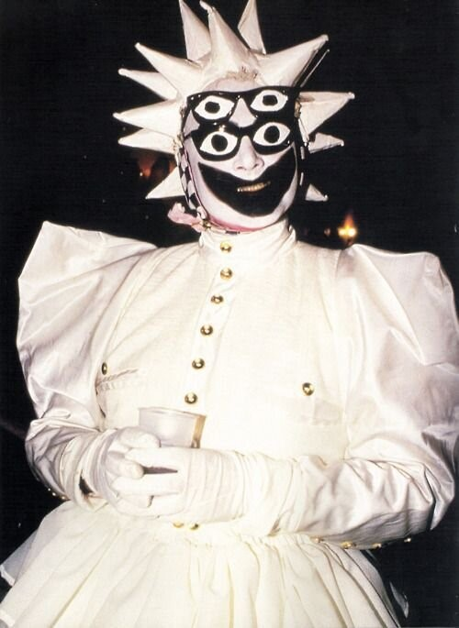
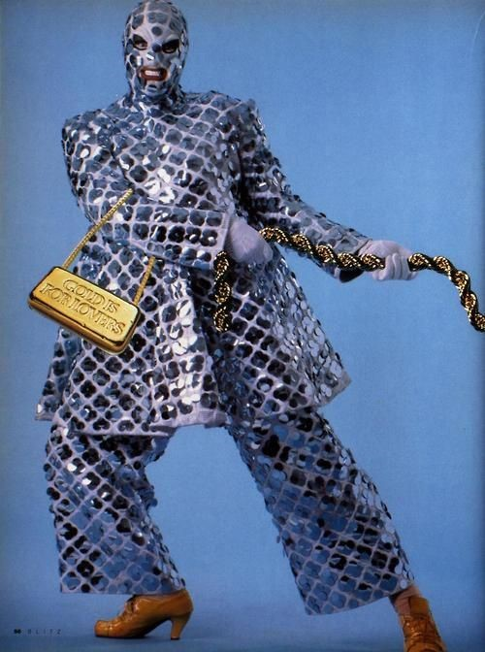
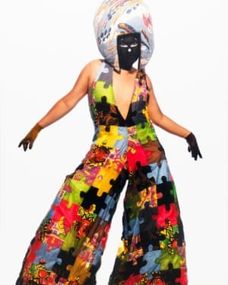
Question 24
Which famous Australian designer and performance artist created these looks? (1 point)

Slide 23
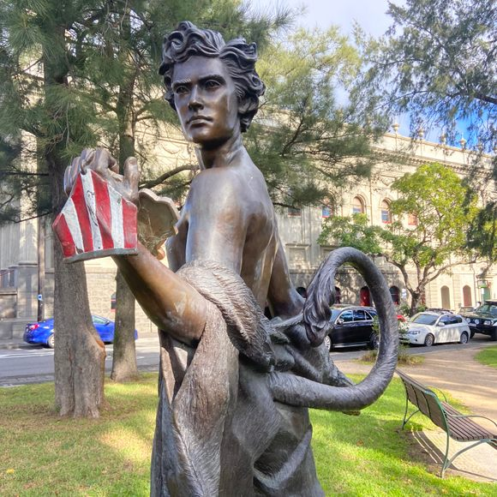
Question 25
In what Melbourne suburb is this statue located? (1 point)
Created by award-winning Melbourne sculptor William Eicholtz, Courage, is a sculpture inspired by the iconic character of the Cowardly Lion in the story The Wonderful Wizard of Oz and his contemplation of what it means to possess the courage to be yourself, no matter who you are.
In which Melbourne suburb is this statue located?
A. South Yarra B. Fitzroy
C. Belgrave D. Melton
#RMITPride
rmit.edu.au/prideweek

Slide 24
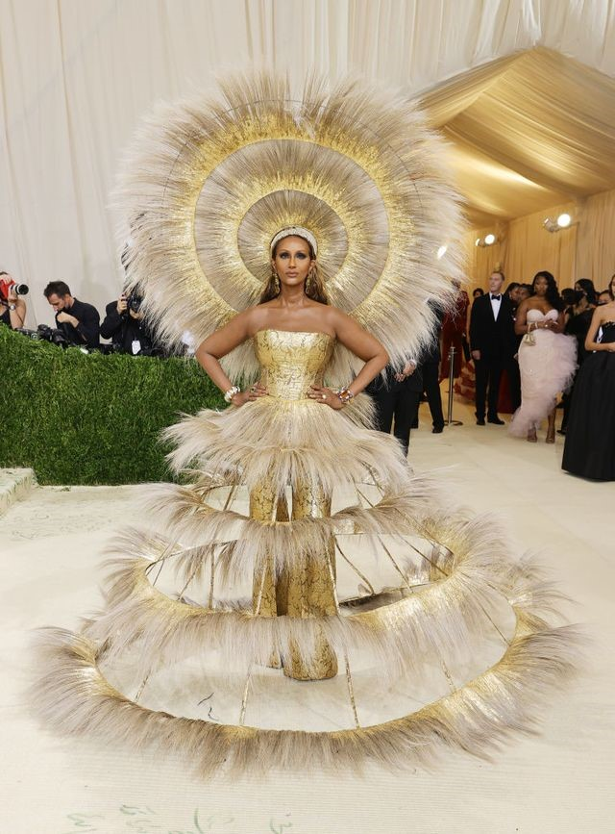
Question 25
Which up and coming gender fluid designer created Iman's 2021 Met Gala look? (1 point)
A. Harris Reed
B. Brandon Maxwell
C. Hana Holquist
D. Thierry Mugler
#RMITPride
rmit.edu.au/prideweek

Slide 25
Let's go through the answers
Don't forget to count your score!
#RMITPride
rmit.edu.au/prideweek

Slide 26
Flags and terminology
Pop culture
History
Q1. Bisexual flag, Transgender flag, Intersex flag, Non-binary flag, and Pansexual flag (1 point per correct answer)
Q2. Non-binary (1 point)
Q3. Heteronormativity (1 point)
Q4. Black, gray, white, purple (1 point)
Q5. Gender euphoria (1 point)
Q6. Queen Latifah, Sam Smith, Courtney Barnett, Miley Cyrus, Janelle Monae (1 point per correct answer)
Q7. Kita Mean (1 point)
Q8. Rami Malik (1 point)
Q9. Paris is Burning (1 point)
Q10. Grace and Frankie (1 point)
Q11. Uncle Jack Charles, Courtney Act, Penny Wong, Cate McGregor, Magda Szubanski (1 point per correct answer)
Q12. 1969 (1 point)
Q13. The 78ers (1 point)
Q14. Captain Moonlite (1 point)
Q15. Lesbos (1 point)
#RMITPride
rmit.edu.au/prideweek

Slide 27
Political
Sport
Art & fashion
Q16. Spain (2005), France (2013), Colombia (2016), Australia (2017), Ecuador (2019) (1 point per correct answer)
Q17. 2016 (1 point)
Q18. Tasmania, holding out until 1997 (1 point)
Q19. 1990 (1 point)
Q20. 1991 (1 point)
Q21. Leo Baker – Skateboarding, Hannah Mouncey – AFL, Mercedes Martinez – Wrestling, Jason Ball – AFL, Ian Roberts – Rugby, Megan Rapinoe – Football / Soccer (1 point per correct answer)
Q22. Billie Jean King (1 point)
Q23. David Hockney, David Wojnarowicz, Frida Khalo, Andy Warhol (1 point per correct answer)
Q24. Leigh Bowery (1 point)
Q25. Fitzroy (1 point)
Q26. Harris Reed (1 point)
#RMITPride
rmit.edu.au/prideweek

Slide 28



How did you do?
Time to tally up your scores, declare a winner and allocate prizes (if you're playing for prizes).
There were a total of 50 points on offer – what did you score?
You can share your scores on Yammer using #RMITPride
Don’t forget to join us for some great events during the week!

Slide 29
Thank you
#RMITPride
rmit.edu.au/prideweek

