Slide 1
— Diploma of Commerce
A one year program equivalent to the first year of the Bachelor of Business
An exciting alternative for international students!!!
Program Manager Annitta Siliato
Notes:
To create Em dash above headline:
Same size and weight as the headline and set using a soft return.
PC: Em dash (—): Alt+Ctrl+ - (minus)
Mac: Em dash (—): Shift+Alt/Option+hyphen

Slide 2
How is the Diploma of Commerce the SAME as the first year of a Bachelor of Business?

Slide 3
Students study the SAME eight Common Core Business Courses
Bachelor of Business-Year One
Accounting and Organisations
Business Computing
Prices and Markets
Macroeconomics
Business Statistics
Marketing Principles
Introduction to Management
Commercial Law
Diploma of Commerce-One Year
Accounting and Organisations
Business Computing
Prices and Markets
Macroeconomics
Business Statistics
Marketing Principles
Introduction to Management
Commercial Law

Slide 4
PEACE OF MIND Pass all eight courses=guaranteed entry into second year of bachelor of business.
Students must gain 50% for each course and reach a GPA of 1.0

Slide 5
So what are the other benefits of the Diploma of Commerce?

Slide 6
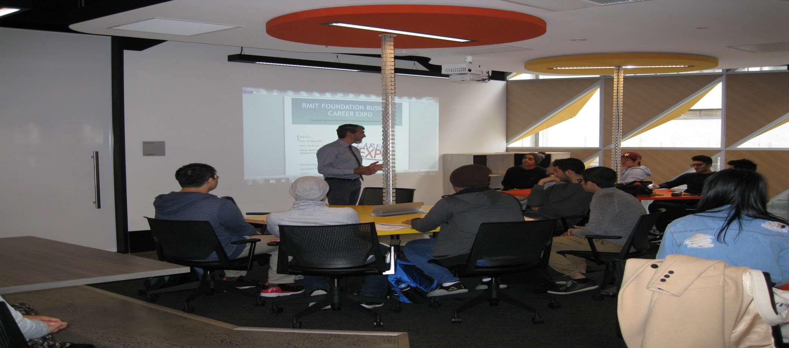
Small class sizes plus individual and personalised learning=HIGH PASS RATES Pass rate for 2018-85%
Notes:
To create Em dash above headline:
Same size and weight as the headline and set using a soft return.
PC: Em dash (—): Alt+Ctrl+ - (minus)
Mac: Em dash (—): Shift+Alt/Option+hyphen

Slide 7
Work Integrated Learning with real industry clients=BUILDING CONFIDENCE WITH JOB SKILLS.
Some previous clients-Telstra, NAB, Hugo Boss, Dusk, The Langham, Deloitte, Zoos Victoria, Country Road, Transurban, Optus.

Slide 8
Diploma of Commerce plus Bachelor of Business(Dual qualifications)= IMPRESSIVE PROFILE FOR EMPLOYMENT. BONUS OF COST SAVINGS

