Slide 1
— Business skills for a digital future
Martin Dick
Program Manager

Slide 2
Why Digital Business?
Global disruption
The Digital Economy is growing rapidly.
200 million digitally connected consumers – up 50% since 2016.^
Is 5% of global GDP.
Business transformation
Accelerating pace of disruption in organisations.
Automation, AI, Big Data and IoT trends are changing the face of work.
Skills demand
Demand for employees who are aligned with the digital economy.
Innovation is a priority for many businesses.
^ASEAN 2017

Slide 3
What is the Digital Business degree?
Explores the emerging digital economy
Develops modern, forward thinking skill-sets and mindsets to achieve strategic goals
Application of industry-used digital tools
Authentic learning experiences
2 Work-Integrated Learning courses
End of program Capstone course
Industry involvement with all courses
Working in an agile and collaborative environment

Slide 4
The outcomes
User and customer experience skills
How to transform organisation’s using digital business
Understanding of a breadth of contemporary business issues
Fundamentals of digital business
How to build a digital business
Using and understanding collaborative technology

Slide 5
Who thinks a degree about Digital Business is a good idea?

Slide 6
Comments from Industry
‘This program would prepare students for jobs in: Digital Consulting, Strategy Consulting, Experience Design Consulting, Innovation and Marketing’
“Aligns with ‘modern day consulting’ thinking.”
“Meets a current need within industry and government (Australia and worldwide) for graduates with this type of skillset and knowledge.”
“Fits across numerous business functions of a large and complex organisation such as consulting firms.”

Slide 7
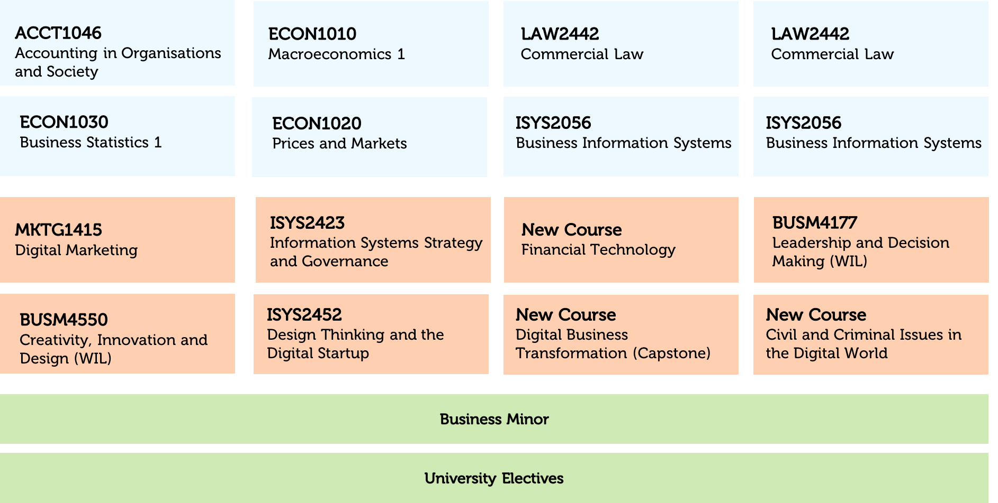
Digital Business Degree Structure

Slide 8
What are the career outcomes?
Business Analyst
Systems Analyst
Business process consultant
Technology Manager
Project Manager

Slide 9
Making most of the degree
Micro-credentials
Complementary Business Minors
Blockchain
Information Systems
Business Analyst
Security and Risk Manager

Slide 10
When is it happening?
Semester 2, 2019

Slide 11
— Questions?

