Slide 1
— Engineering with Options – the Student Experience Zachary McClelland Hyperloop team leader

Slide 2
My long journey to Hyperloop Technology
Returned to high school at age 21 to re-sit my VCE
Entered into RMIT doing an Associate Degree in Engineering
Moved across to a Bachelor of Aerospace Engineering
Finished my degree at the end of last year

Slide 3
Associate Degree
Great entry into an engineering degree
Few extra hours a week
Smaller classes than the bachelor so more one on one time with teachers

Slide 4
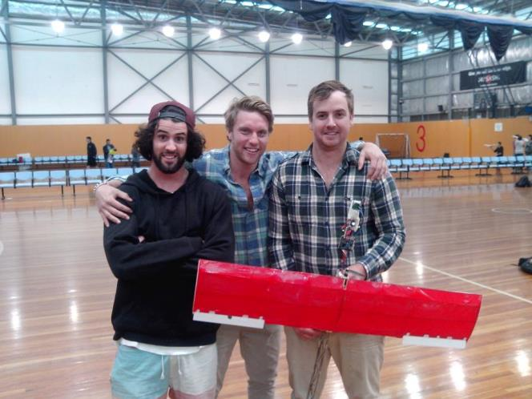
Bachelor of Engineering
Very challenging classes
Every class was very rewarding though
Good mix of hands on and theoretical experience
Practical classes and design is a big part of the degree
Got to work with like minded people
Mandatory12 week work experience gives industry experience

Slide 5
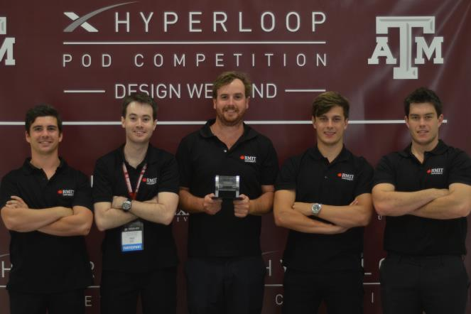
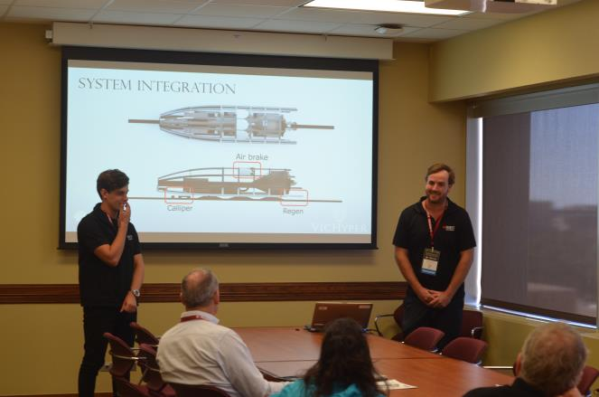
VicHyper
Presenting to some of the best engineers in the world

Slide 6
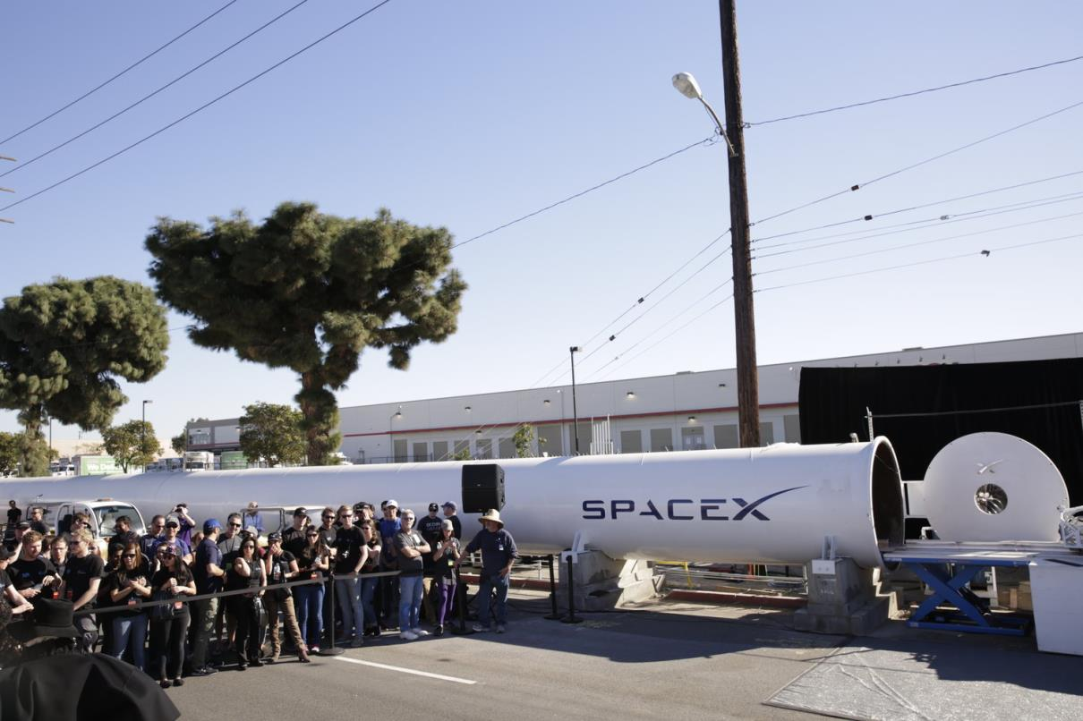
VicHyper

Slide 7
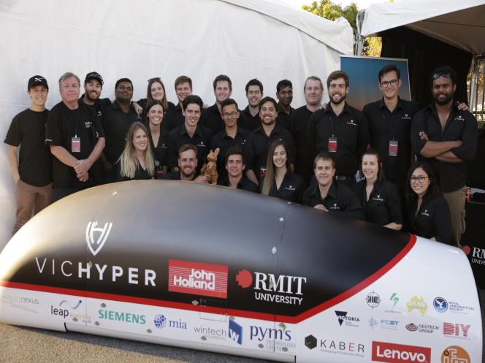
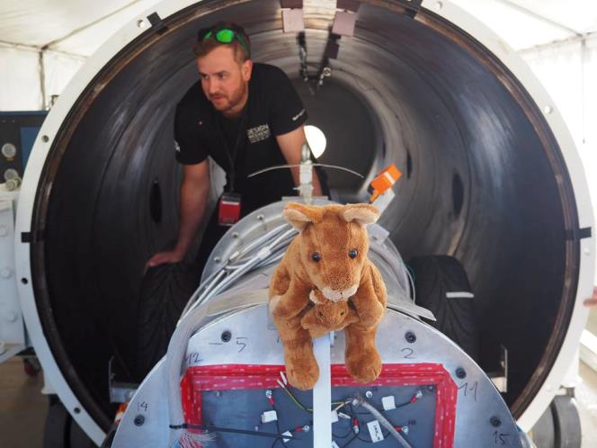
SpaceX
The team
Testing

Slide 8
The Future of VicHyper
We are going to break the barriers of distance

