Slide 1
— How Data and Information Systems Shape Business Environments
Thomas Jewell
Bachelor of Business (Information Systems)

Slide 2
About Me
Bachelor of Business (Business Information Systems) Student
Fan of all things tech and business
Global citizen

Slide 3
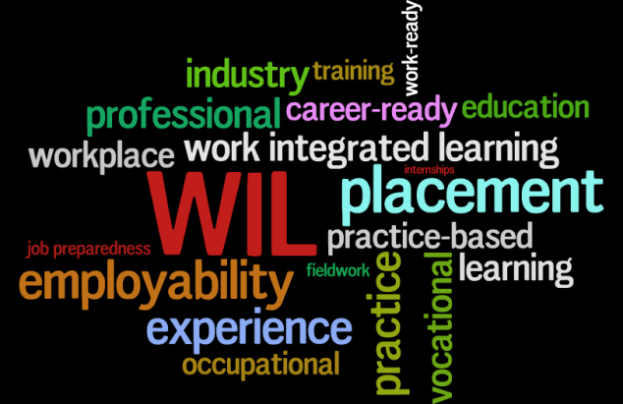
The IBL Program
School of Business WIL
Placement at PwC in Data Assurance

Slide 4
The World of Data

Slide 5
An Information Revolution
Transparency, Accountability and Progress
Converting data to information, information to knowledge, and knowledge to wisdom
Very real impacts to the business sphere and the world at large

Slide 6
What this Means for You
A massive opportunity, for our students, our staff and our institutions
Get involved!

Slide 7
— Thank you!
How Data and Information Systems Shape Business Environments Tom Jewell

