Slide 1
— How RMIT is Preparing the Next Generation of Female Leaders
Jessica Pallant and Brianne Johnston

Slide 2
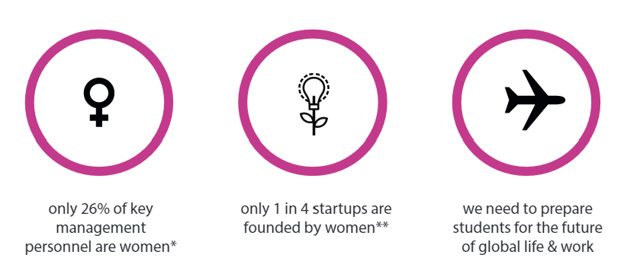
Challenges

Slide 3
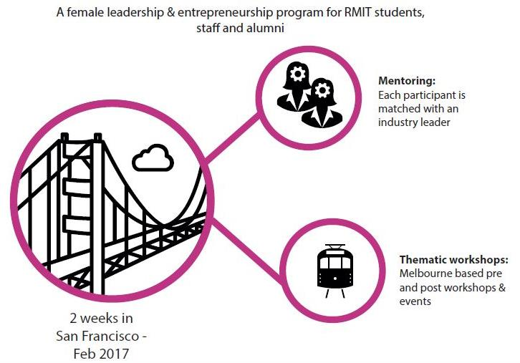
Bright Sparks

Slide 4
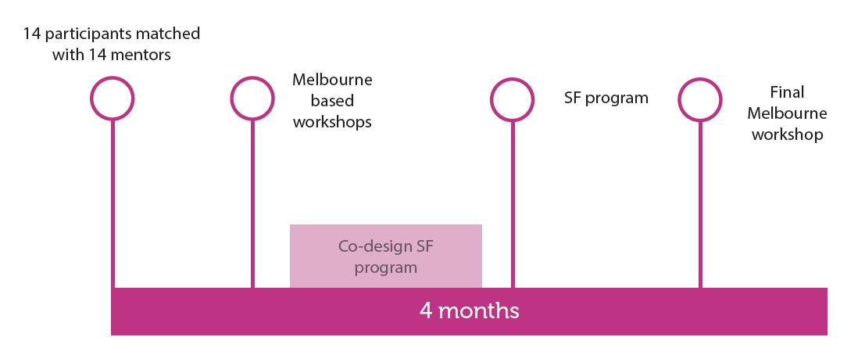
Structure

Slide 5
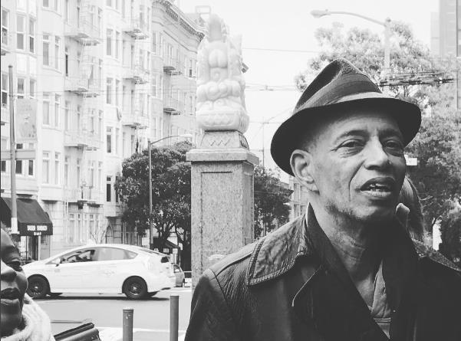
“Never doubt that a small group of thoughtful, committed citizens can change the world; indeed it’s the only thing that ever has.”
– Margaret Mead
Photo: Kate Bromley
Notes:
Power of a community

Slide 6
From Aerospace Engineers to Marketers to Writers, Bright Sparks connected a diverse, interdisciplinary group of women

Slide 7
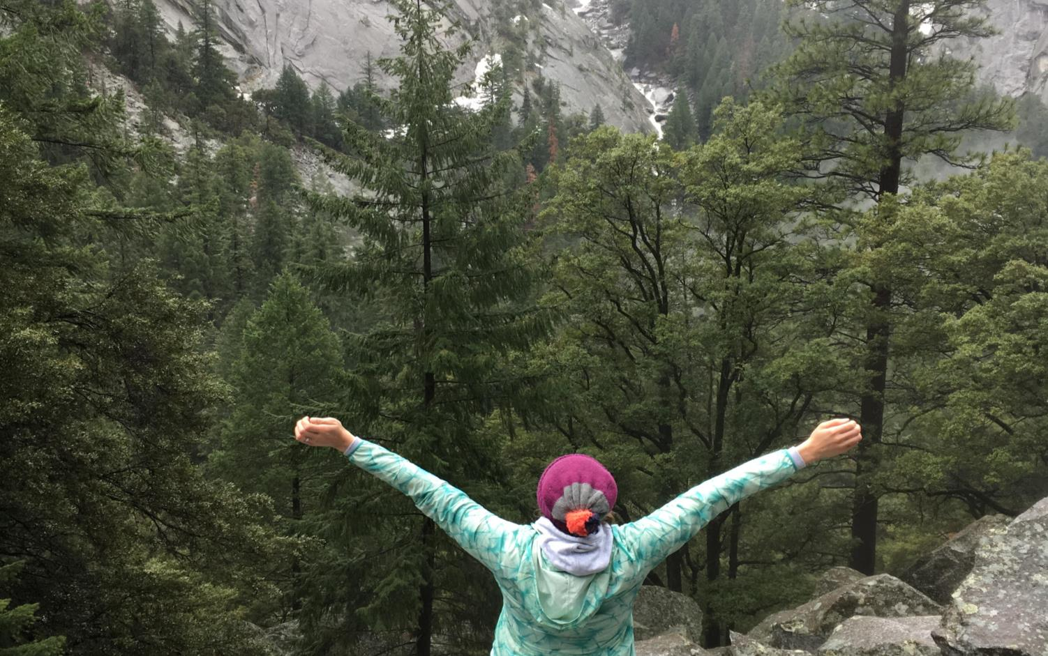
“Seeing the extreme polarisation of San Francisco (poverty and wealth) has given me clarity in what I want to focus on in my career. I don't need to be at the extreme end to have an impact”– Jessica Pallant
Notes:
Confidence.

