Slide 1
—
Media and Communication
Professor Dr Martyn Hook
Dean, School of Media and Communication
Deputy Pro Vice-Chancellor, Partnerships
College of Design and Social

Slide 2
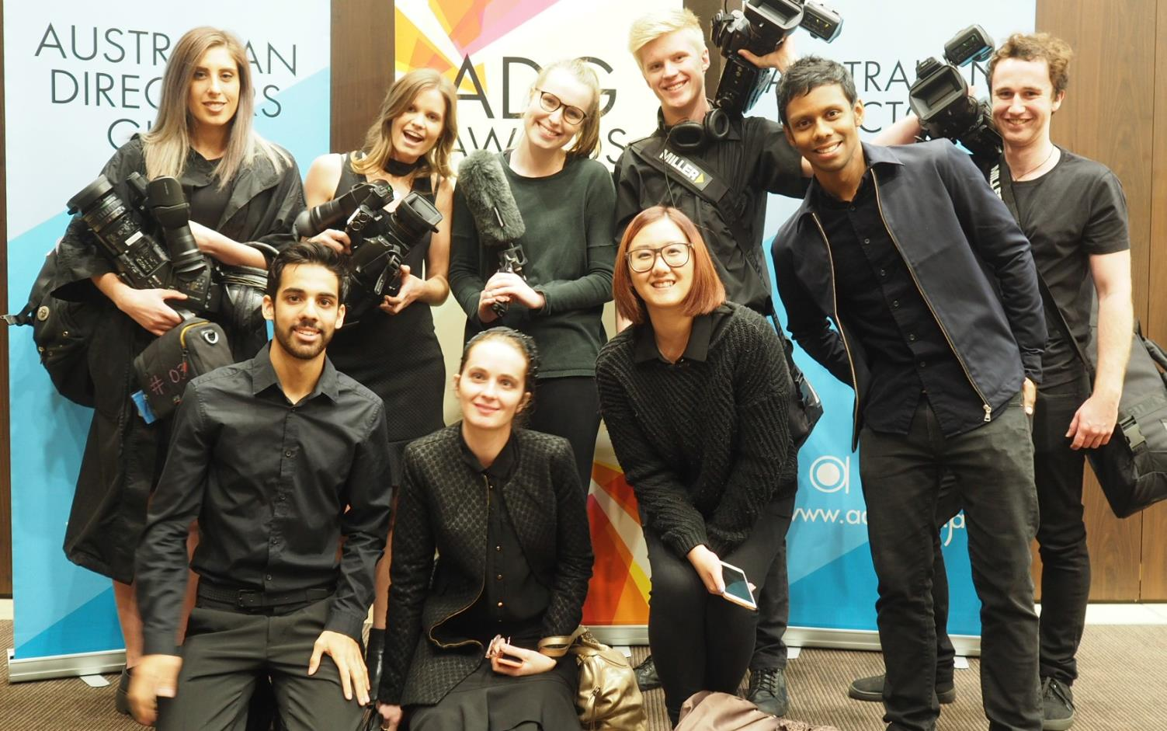


School of Media and Communication
Bachelor of Communication (Media) Student team working to film and edit the
2016 Australian Directors Guild Awards

Slide 3
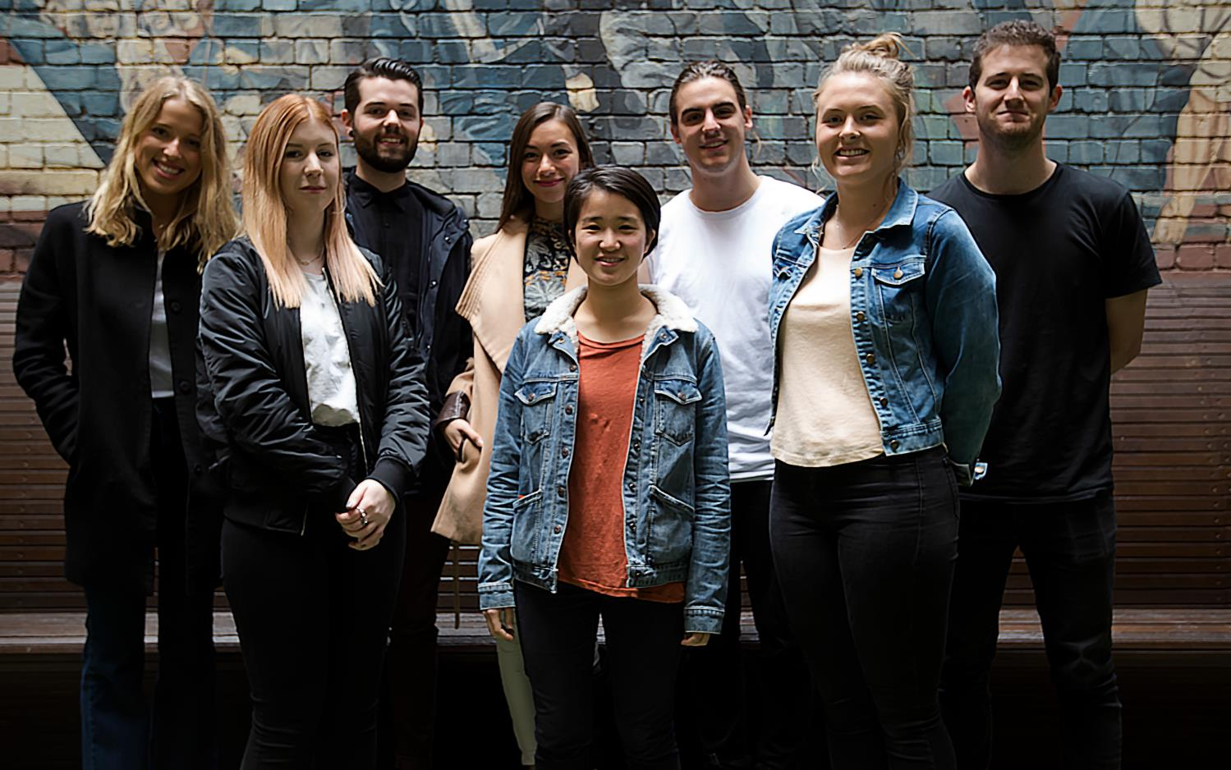
Bachelor of Communication suite
Bachelor of Communication (Advertising) Student teams nominated to the
2016 Cannes Future Lions Awards

Slide 4
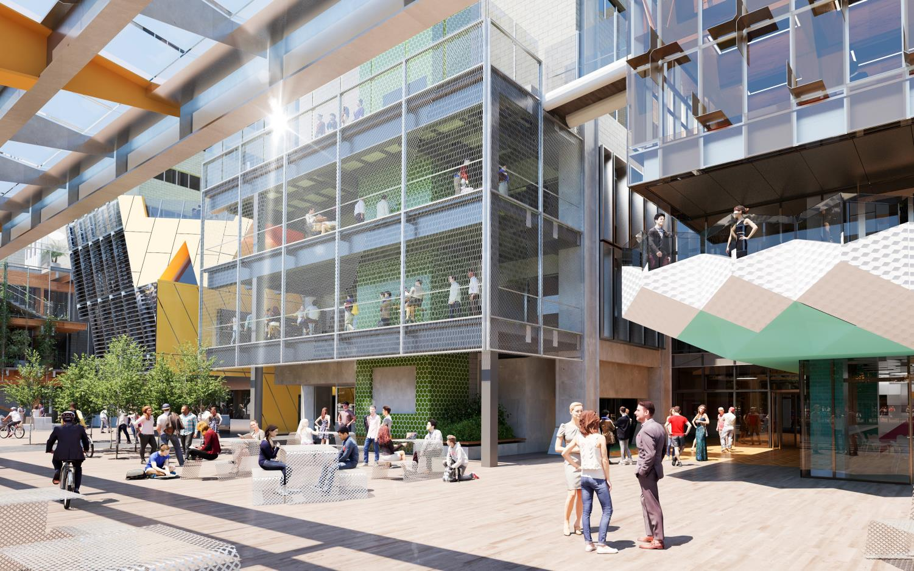

New Academic Street & Media Precinct
New Academic Street & Media Precinct Featuring brand new studios and equipment
Media Portal, Media Street and Studios

Slide 5
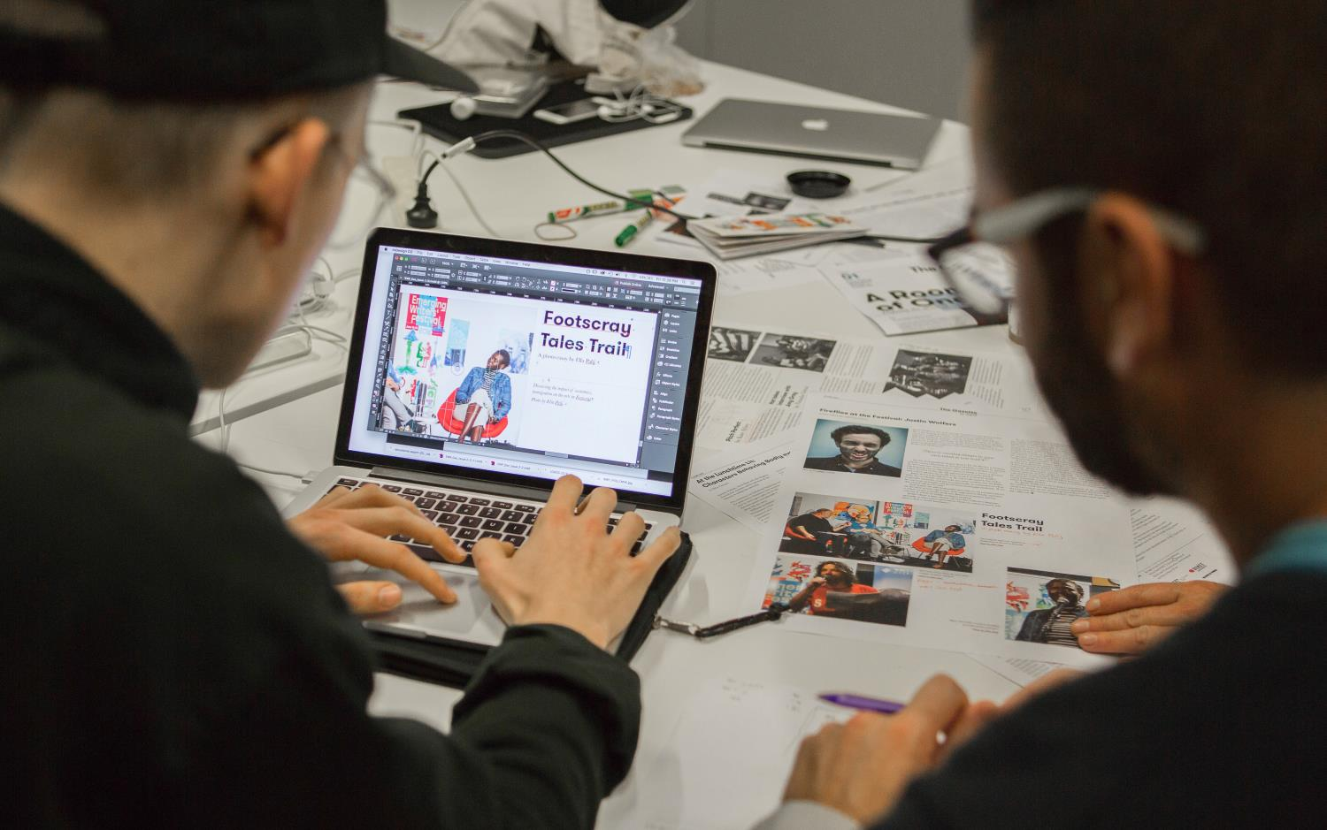
Work Integrated Learning
The Gazette
Cross-discipline WIL project as part of the
2016 Emerging Writers Festival

Slide 6
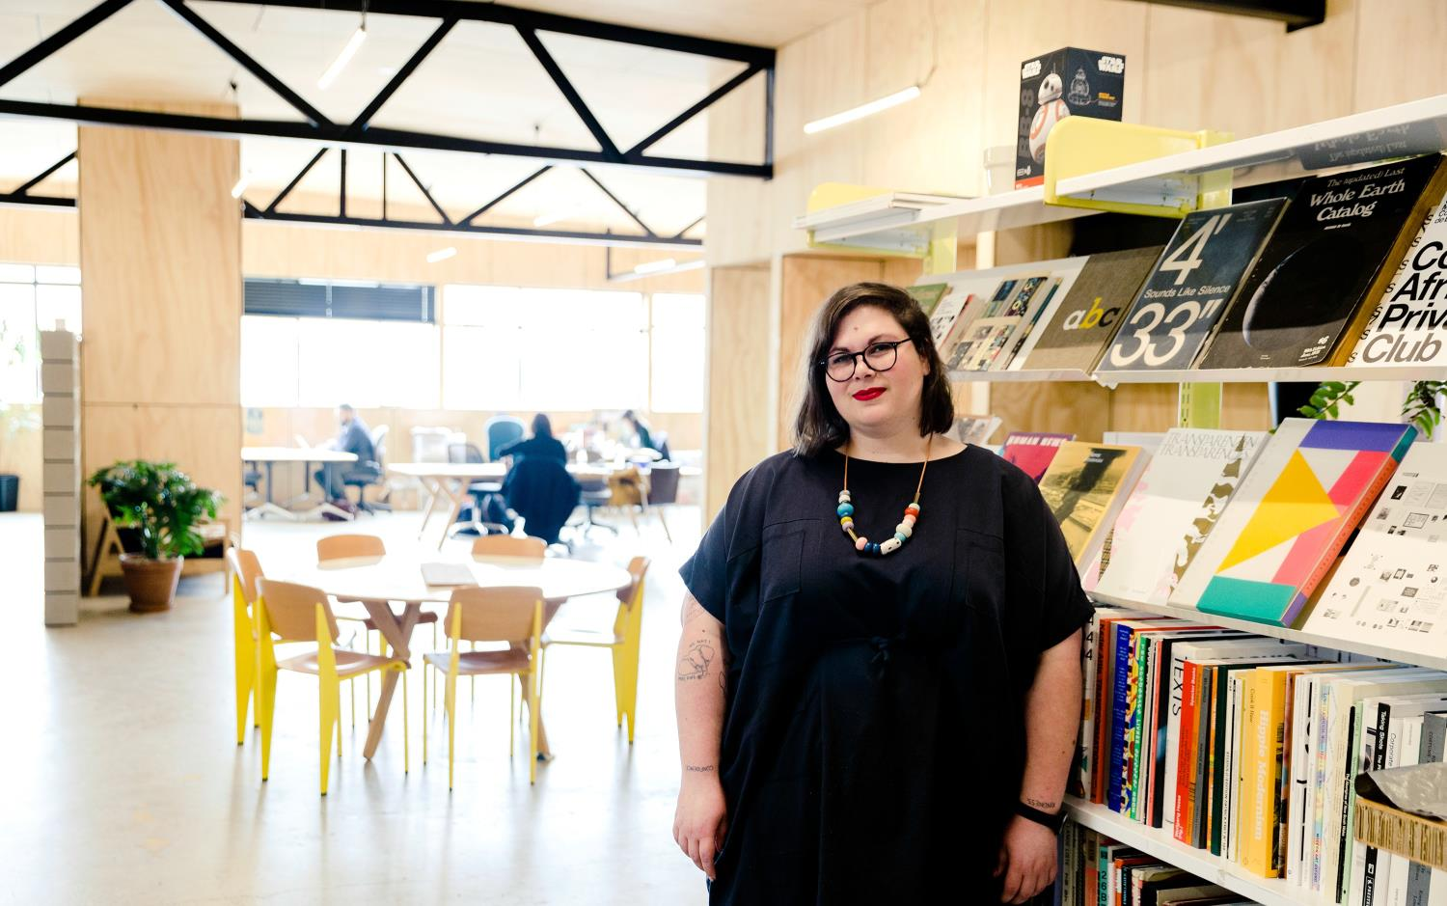
Employability and outcomes
Brodie Lancaster, Graduate Bachelor of Communication (Media)
Author, Editor and Social Media Manager

