Slide 1
Europe, the Asia Pacific and the Global Transformation Agenda
The European Union and Sustainable Development Goal 17: maintaining, nurturing and establishing partnerships in uncertain times
Damian Privitera, RMIT University
Maren Klein, RMIT University
25 March 2021
Notes:
Instructions
To create em dash above headline
Same size and weight as the headline and set using a soft return.
PC: Em dash (—): Alt+Ctrl+ - (minus)
Mac: Em dash (—): Shift+Alt/Option+hyphen

Slide 2
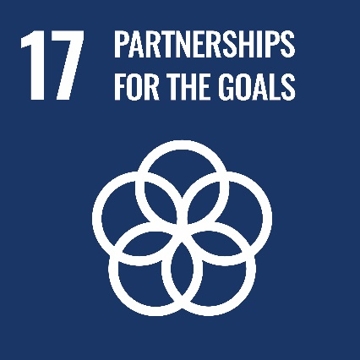

Strengthen the means of implementation and revitalize the global partnership for sustainable development
“A successful sustainable development agenda requires partnerships between governments, the private sector and civil society. These inclusive partnerships built upon principles and values, a shared vision, and shared goals that place people and the planet at the centre, are needed at the global, regional, national and local level”(UN).
Partnerships are voluntary and collaborative relationships between various parties, both public and non-public, in which all participants agree to work together to achieve a common purpose or undertake a specific task and, as mutually agreed, to share risks and responsibilities, resources and benefits (UN).

Slide 3
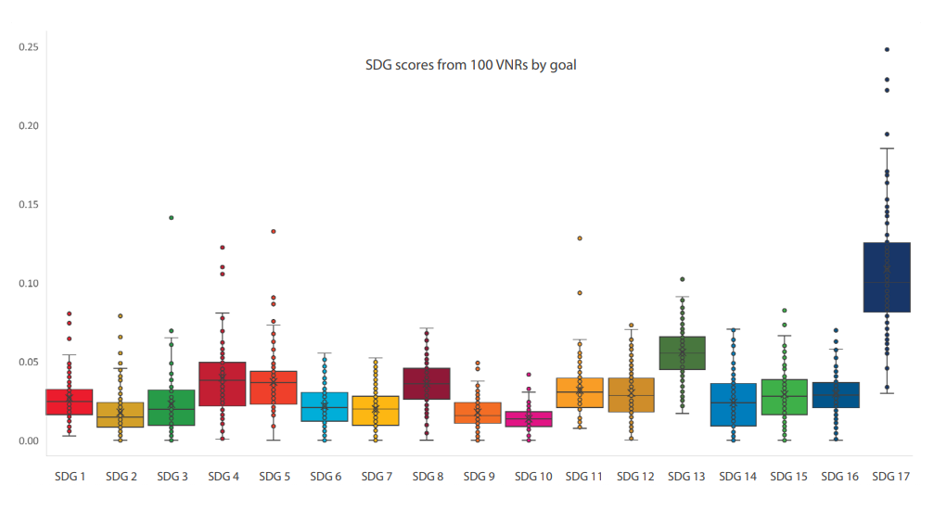
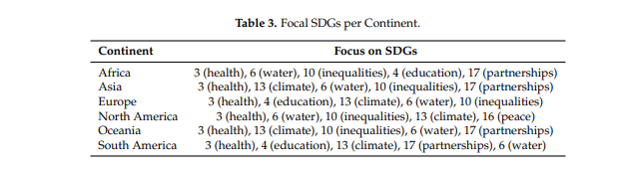
The importance of SDG 17
Source: Committee for Development Practice
Source: Meschede, 2020

Slide 4
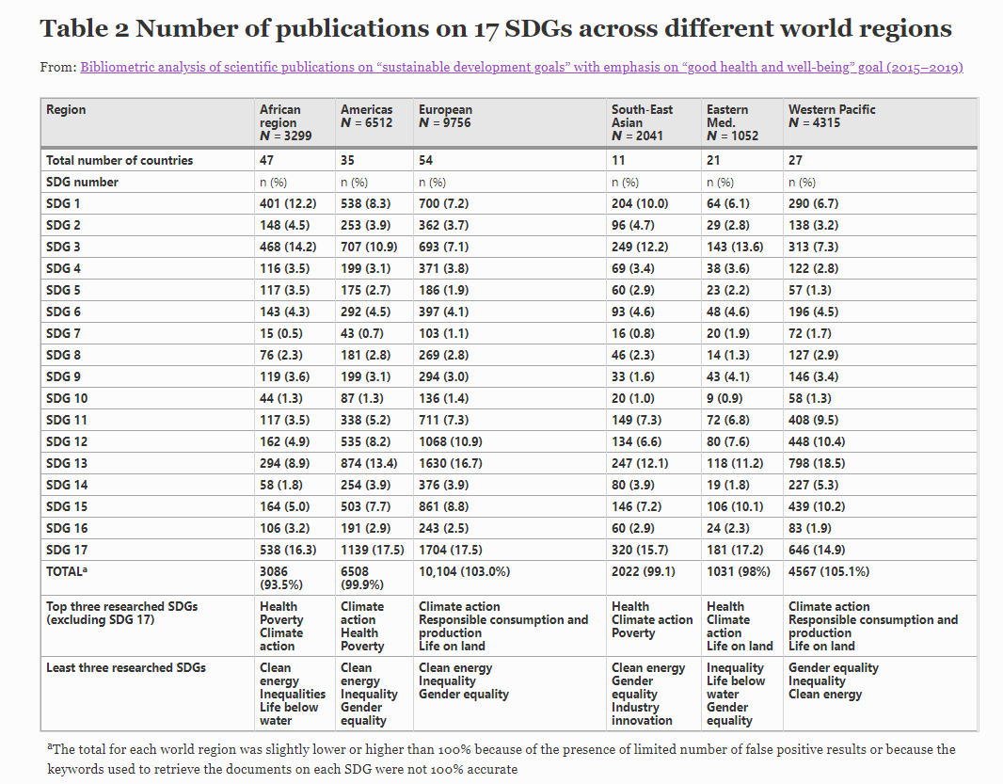
Number of publications on SDGs across different world regions
Source: Sweileh, 2020

Slide 5
SDG 17- Targets
19 Targets (goals) and 25 Indicators (metrics to measure achievement)
The targets can be broken down into five categories:
Finance: Targets 17.1 to 17.5
Technology: Targets 17.6 to 17.8
Capacity building: Target 17.9
Trade: Targets 17.10 to 17.12
Systemic issues: Targets 17.13 to 17.19

Slide 6
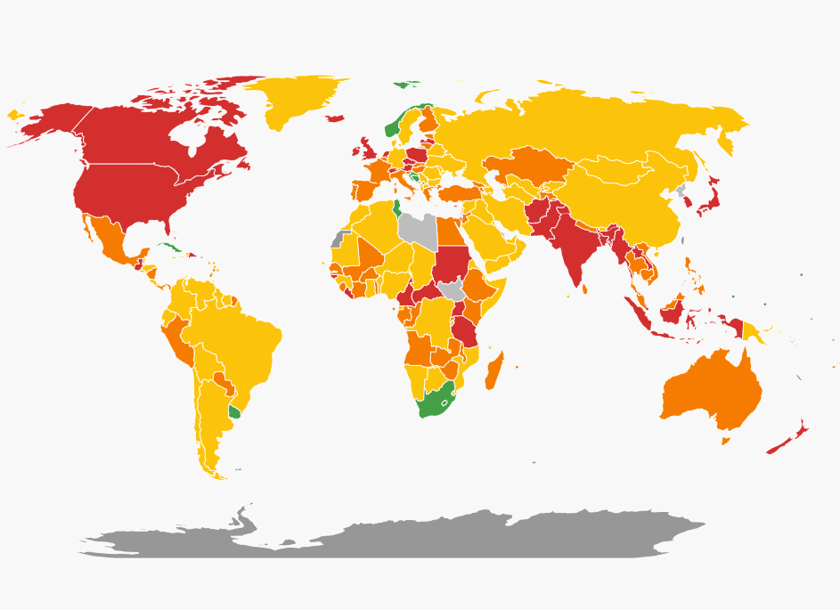
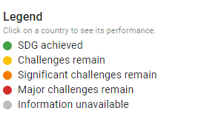
How is the world tracking against SDG 17
Covid-19 impacts (expected)
Decline in ODA, trade, foreign direct investment (FDI) and remittances
Highlights global divide in technology availability
  only 20% of people in Oceania (excl. Australia and New Zealand), 26% in Sub-Saharan Africa have internet access
Endangers funding for implementation of national statistical plans
Restricts multilateralism
Source: Sachs et al., 2020
https://dashboards.sdgindex.org/

Slide 7
The EU as a development actor
The European Consensus on Development of June 2017 has partnerships as one of its central ideas.
Chapter 3 outlines the EU’s understanding that it is necessary to forge deep and wide partnerships across all sectors of society
The Consensus takes a comprehensive approach to implementation, combining aid with other resources, with sound policies and a strengthened approach to Policy Coherence for Development.
The Eurostat 2020 SDG monitoring report, with reference to the Consensus, outlines the need to dedicate a high proportion of official development assistance to least developed countries and other low income countries and focuses on aid and funding.

Slide 8
How is the EU tracking against SDG 17
The Eurostat 2020 monitoring report focuses on the importance of global macroeconomic stability and the need to mobilise financial resources for developing countries from international sources, strengthened domestic capacities for revenue collection and the importance of trade for developing countries and equitable rules for governing international trade (Eurostat, 2020)
Progress against SDG 17 is uneven and slow
imports from developing countries continued to grow
financial support the EU provides to developing countries has fallen in recent years (mainly a result of strong annual fluctuations in private flows)
official development assistance (ODA) has grown slowly
EU’s ratio of ODA to gross national income (GNI) has fallen since 2016, putting the EU off track towards reaching its target of dedicating a share of 0.7% of GNI to ODA by 2030

Slide 9
Why the Africa-EU Renewable Energy Cooperation Programme (RECP)?
According to the IEA, Africa is set to become increasingly influential in shaping global energy trends over the next two decades due to large-scale urbanisation
Current policy and investment plans in African countries do not meet the energy needs of a rapidly growing and young population (The Africa Energy Outlook, 2019)
Presently, 590 million people in Africa do not have access to electricity, rising by 13 million in 2020 due to the adverse effects of the pandemic. This is in contrast to growth seen from 2013-19
Why Europe? "Climate change is a direct and existential threat, which will spare no country” (European Council, 2019).
Notes:
- the number of individuals without access to electricity increase from almost 600 to 630 million by 2030.
Purpose for RCEP- energy availability in Africa – why is this partnership needed?

Slide 10
Why the Africa-EU Renewable Energy Cooperation Programme (RECP)?
“We need to be clear, we cannot envisage a different path between the developing and the developed world (…) This has to be a common effort.” (Francesco La Camera, director-general for Int. Renewable Energy Agency).
Inaction also has consequences. If (developing countries) can leapfrog over centralized fossil-fuelled generation and go straight to onsite generation using renewables, it will have world-wide effects in tackling the climate crisis (Silverstein, 2021).
Notes:
- the number of individuals without access to electricity increase from almost 600 to 630 million by 2030.
Purpose for RCEP- energy availability in Africa – why is this partnership needed?

Slide 11
What exactly is the RECP?
Launched in 2010, the Africa-EU Renewable Energy Cooperation Programme (RECP) aims to overcome the existing constraints and barriers in developing renewable energy in Africa, and to exploit growing opportunities in this sector. (ICA)
Goal: Promoting renewable energy market development in Africa. The programme seeks to maximise opportunities for cooperation between governments, NGOs, research institutions and universities, and business organisations in Europe and Africa. (European Commission)
Funding sources: the European Commission, Austria, Finland, Germany and the Netherlands.
The RECP Start-up Phase is funded by the European Union under its Environment and Sustainable Management of Natural Resources including Energy (ENRTP) Programme. (Infrastructure Consortium of Africa)
Notes:
- the number of individuals without access to electricity increase from almost 600 to 630 million by 2030.
Purpose for RCEP- energy availability in Africa – why is this partnership needed?

Slide 12
Current main objectives and projects
Objectives:
Policy Advisory Services
Private Sector Cooperation
Project preparation and flagship investment projects
Technology, innovation and capacity development
Projects:
Tanzania – Zambia Interconnector
Climate Investor 1 (Nigeria)
Construction of the DEFISOL power plant in Benin, EU, France joint project

Slide 13
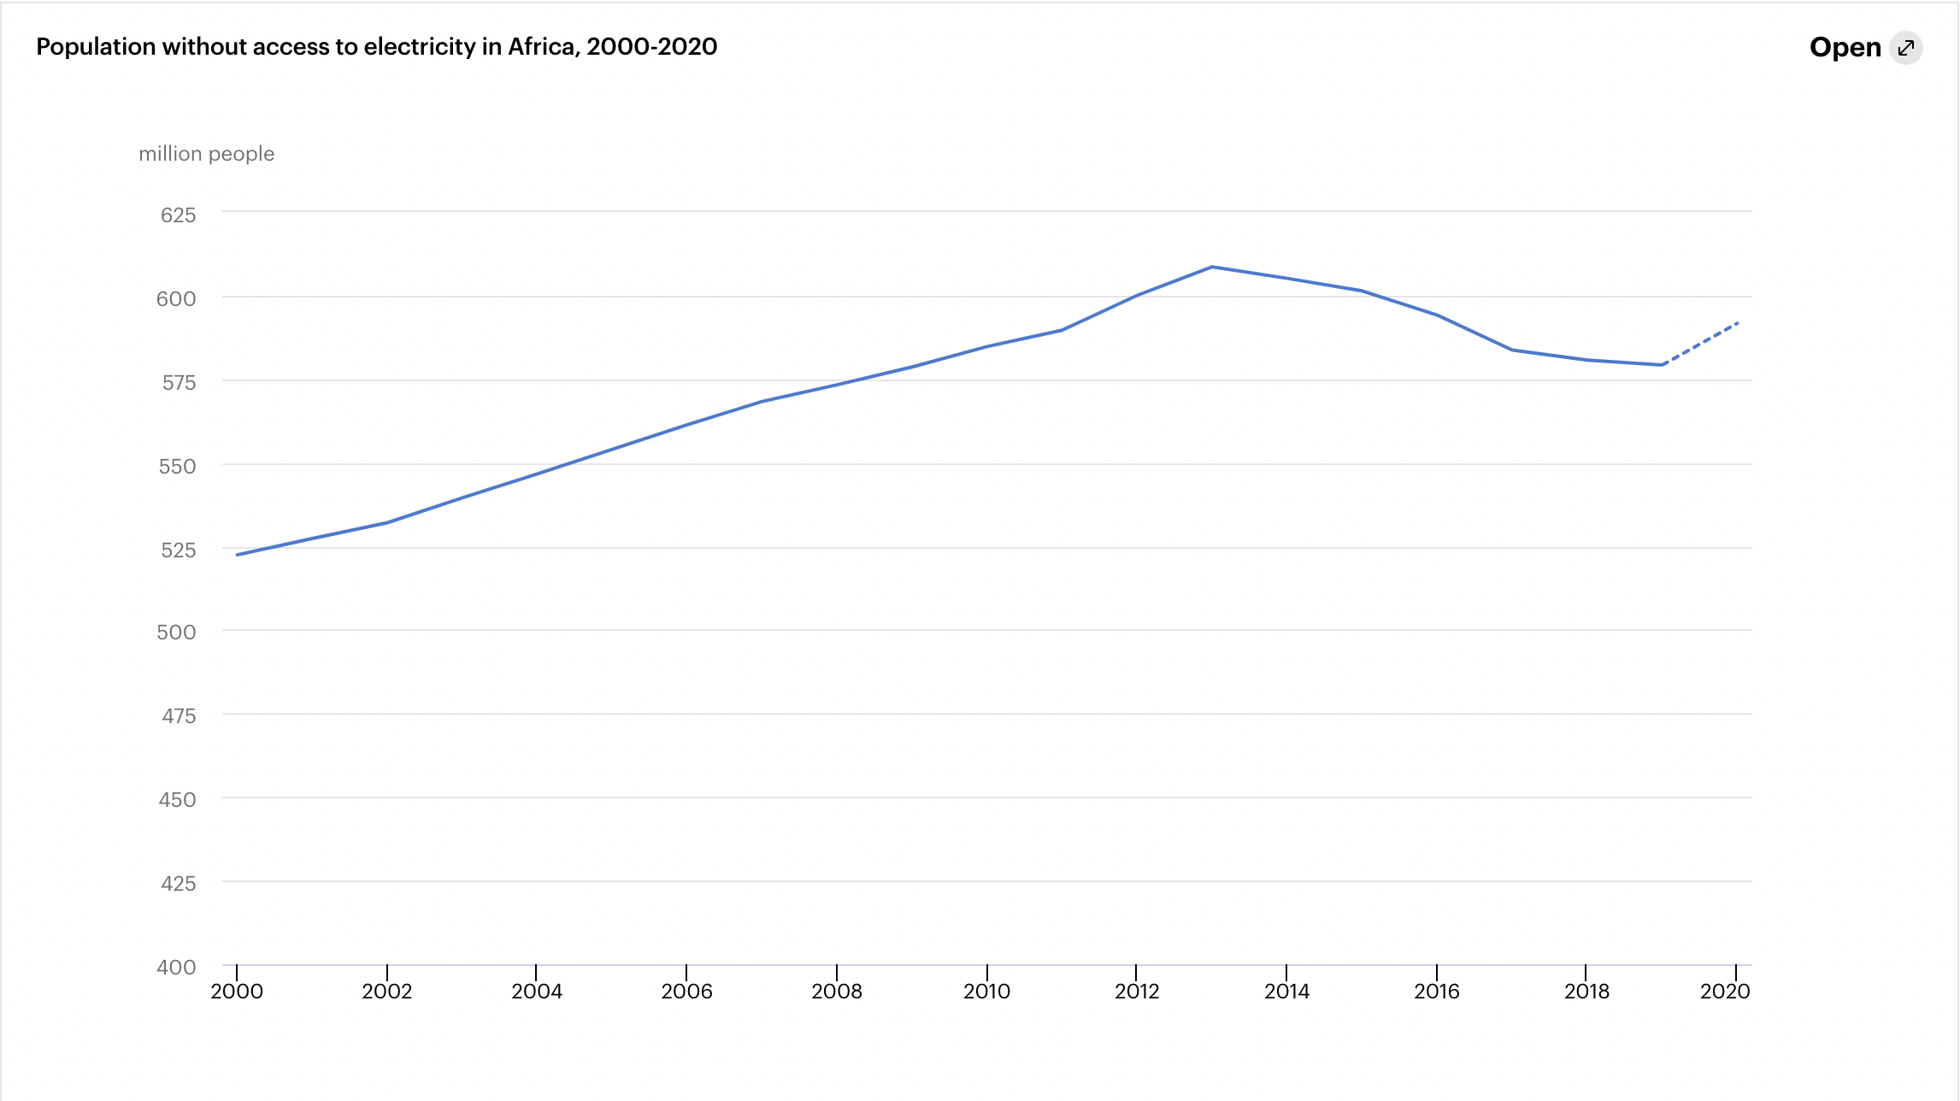
Impact of COVID-19
While energy sustainability as an area of cooperation continues in the period of COVID-19, health and pandemic management has shifted focus energy as the prime focus of EU-African relations.
“The health crisis has forced governments to shift their immediate priorities to purely emergency measures, resulting in a lack of financing available for expanding and improving electricity infrastructure” (IEA).
Urgency: A delayed recovery would see the number of individuals without access to electricity increase from almost 590 to 630 million by 2030.
IEA, 2020

Slide 14
SDG 17 in the Asia-Pacific:
Enhanced Regional EU-ASEAN Dialogue Instrument (E-READI)
From the EU-ASEAN Plan of Action:
Expand Trade, Business and Investment
Strengthen the role of the private sector and Public-Private Partnership
Strengthen Cooperation in Transport, Energy and ICT
Enhance cooperation on research and innovation, Science and Technology
Address regional and global environmental challenges and promote sustainable development (EEAS)

Slide 15
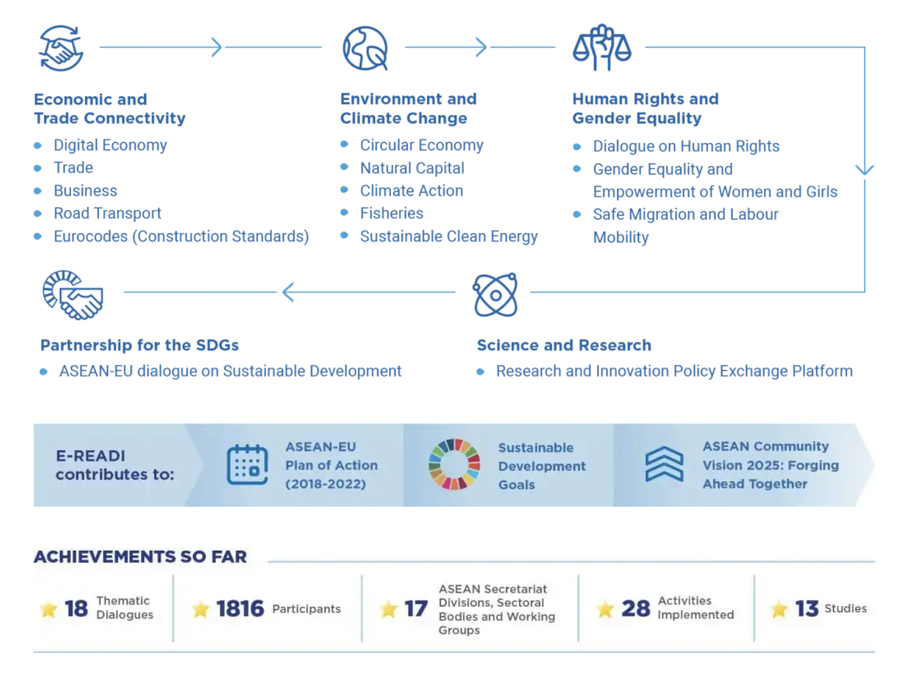
Areas of dialogue on sustainability of energy in E-READI

Slide 16
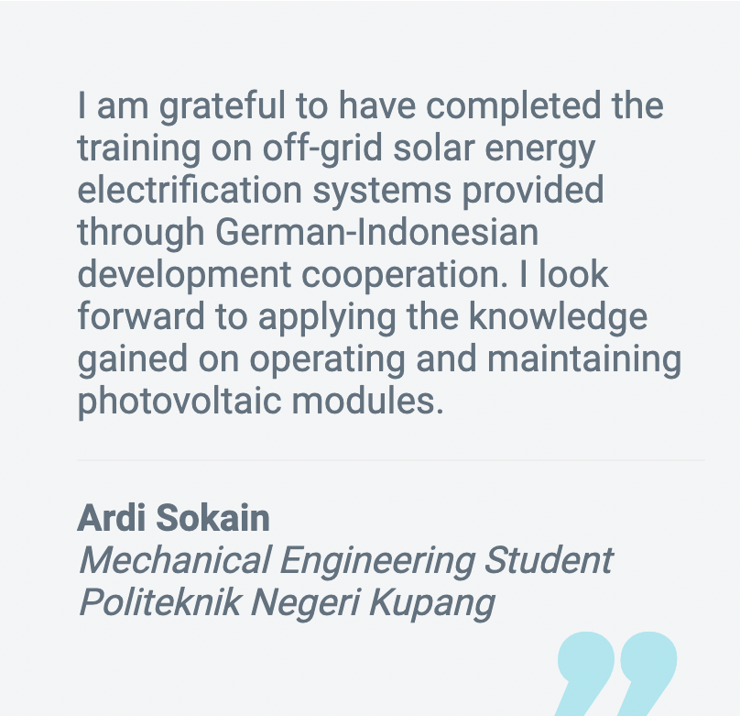
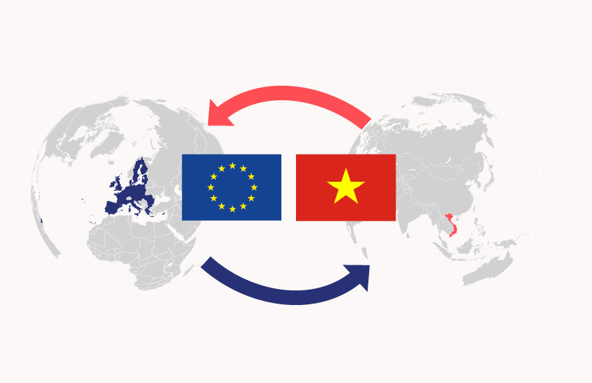
Current Projects
3rd meeting of the Working Group on the Environment and Climate Change (Indonesia and EU, June-July 2020)
EU Vietnam Free Trade Agreement

Slide 17
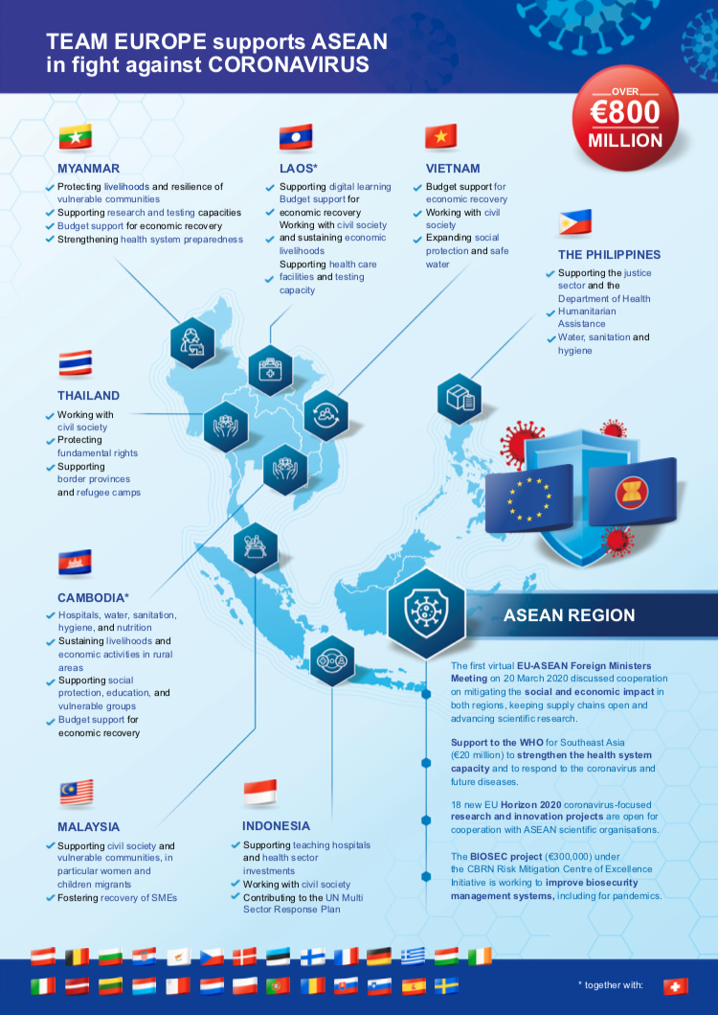
COVID-19 impacts on E-READI
COVID-19 has proven challenging in sustaining partnerships.
The "Team Europe” approach
Over €800 million in grants and loans to support the ASEAN region (EEAS)
In ASEAN States, (Team Europe) targets civil society support, budget support for economic recovery, health care facilities and testing capacities, as well as humanitarian assistance (EU)
Challenges
Regionalism
“national self-help responses paralysing regional cooperation” (Kliem, 2021)
Massive shift towards health, with the sidelining of other action areas including energy.

Slide 18
What apart from money makes a good partnership
Strengthening multilateralism and global partnerships is more important than ever before. The global nature of the pandemic requires the participation of all governments, the private sector, civil society organizations and people throughout the world (UN)
“The SDGs are the world’s shared goals for sustainable development, and Covid-19 makes them more relevant than ever” (Sachs et al., 2020).

Slide 19
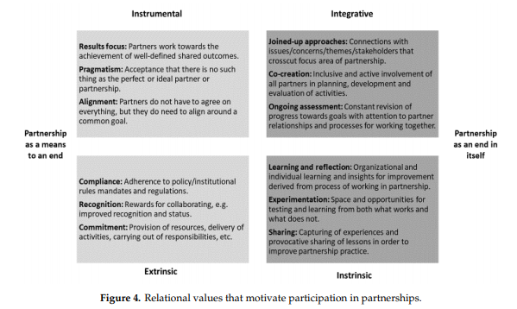
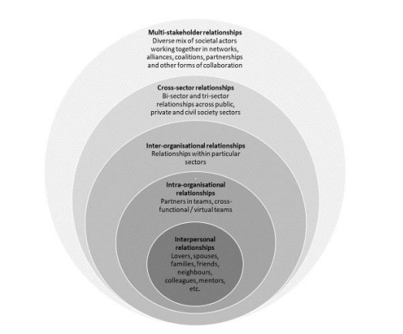
Partnerships
Source: Stott & Murphy, 2020

Slide 20
Thank you

