Slide 1
EUROPE, THE ASIA PACFIC AND THE GLOBAL TRANSFORMATION AGENDA
Transformations: Place, Power and the Sustainable Development Goals
Rachel England, Australian National University
Associate Professor Roberto Guevara, RMIT University
Dr Mary Johnson, RMIT University
Jean Monnet Sustainable Development Goals Network
www.rmit.edu.au/sdgnetwork
7 May 2019

Slide 2

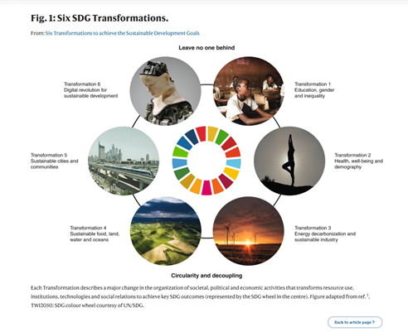
Brief overview of the development of the propeller model: History
The propeller model’s aim was designed to illustrate the role and contribution of the EU as a development actor in the achievement of the UN SDGs in the Asia-Pacific region.
The propeller model aims to examine the SDGs as integrated and interconnected, rather than 17 separate goals.
While Sachs (2015) has managed to cluster the goals into six categories of SDG Transformations, it still presents them as separate goals.
Cashore (2021) on the other hand, argues that the nature of the ‘wicked problems’ we are trying to solve requires that we change the dominant way of responding. Currently mainly through technical solutions, we instead need to reframe how we view these problems and structure our responses recognizing that both have essentially political and moral dimensions.

Slide 3
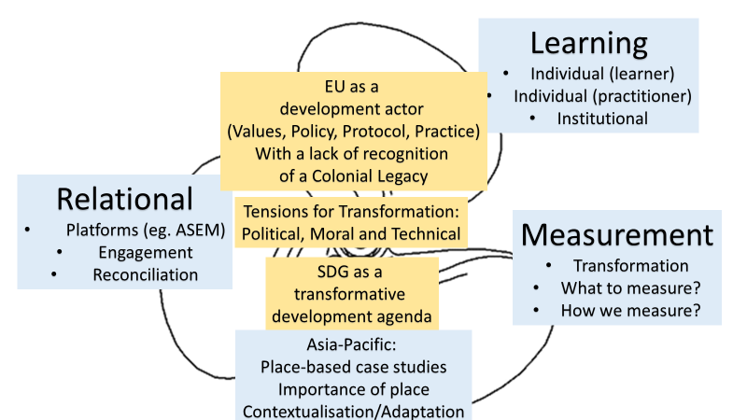
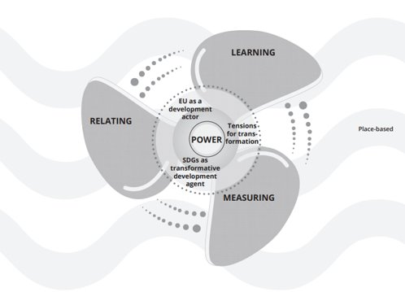
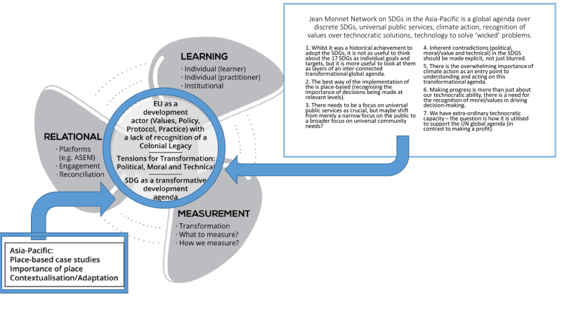
Evolution of the propeller model
Transformations: Place, Power and the Sustainable Development Goals

Slide 4
Brief overview of the development of the propeller model: Key Characteristics
We recognise that the SDGs are indeed a transformational agenda. However, if the SDGs are to truly TRANFORM our world, then those who propose to support and advance the SDGs themselves need to be equally TRANSFORMED - we are all equally transformed as we contribute to transformation.
We recognize that transformation is not merely the end product of the SDGs, but that conceptualising and implementing the SDGs must be equally transformative of process. Finally, we argue that achieving the UN SDGs must be ultimately tangible within a specific place (place-based).
At the same time, we recognise that this is not a one-way or top-down process but a dynamic, reciprocal and iterative, as place-based realities equally influence both development actors and the very essence of the SDGs.

Slide 5

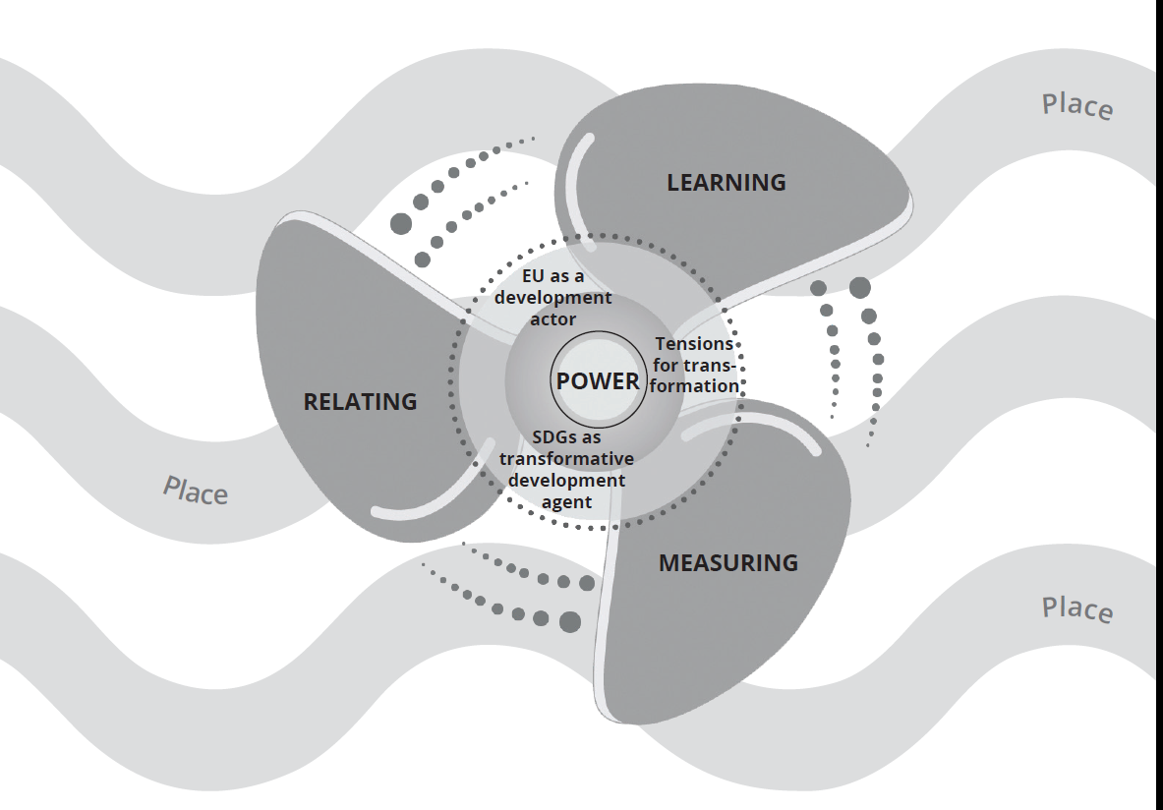
The Propeller Model – Its Elements
A (sustainable) development initiative - the focus.
Power at its core – a productive, energising element.
Place all around - locating and contextualising all the elements.
Three fins to view the SDGs through. The fins turn, blend and transforming themselves and each other, looking back while always moving forward (think of the metaphor of a spiral)…
  Relating, Learning, Measuring.

Slide 6
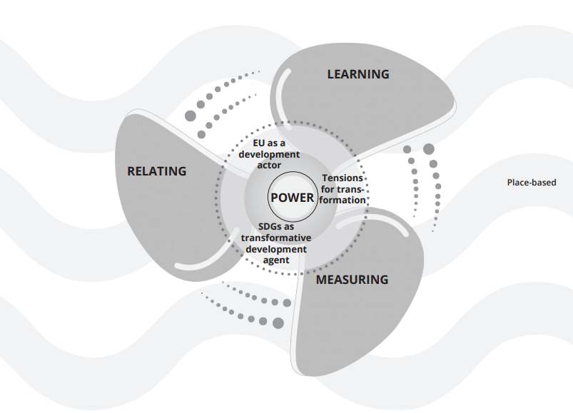
The RELATING Fin of the Propeller
What is relating?
An ubiquitous term – everyone knows what ‘relating’ is…don’t they?
But if I was to ask you to reflect on how we right now are ‘relating’ – exactly…in detail…focusing on the interspaces between us…and to identify the connections we are making as well as the disconnections being concealed – would you easily be able to?
For example, drawing on Cooper (2005): “It is like the silence that is the necessary background to speech but which also withdraws when speech expresses itself and yet is always present as a supportive absence.”

Slide 7
The RELATING Fin of the Propeller
Relating via four R's: relational, reflexive, respectful, reciprocal
When applying the relating fin, time and space and method are important considerations, as:
(Time and Space) “The experiences of daily life are relative to the particular person, their surroundings at a particular moment, and the mood and feelings experienced in that situation.” (Cooper, 2005: 1691)
(Method) “Reflexive relational ethics pays attention to the balance required between our own needs as researchers [and practitioners] and our obligations toward, care for, and connection with those who participate in our research.” (Etherington, 2007: 614)

Slide 8


A Relating Story…
The long lunch (Samoa).

Slide 9
RELATING and the SDGs
UN Resolution 70/1 Transforming our World: the 2030 Agenda for Sustainable Development.
17 SDGs and 169 Targets – ‘interlinked’, ‘integrated’, ‘indivisible’.
Intended to be implemented via collaborative partnerships across the world.
This related approach is crucial to achieving the UN’s 2030 vision.
But does this mean that the SDGs are relational?

Slide 10
The RELATING Fin of the Propeller
Applying the Relating Fin to the SDGs
The what? of relating falls into three categories:
Institutional relating – solidarity and partnership of Global actors (e.g. States, parliaments, international institutions, local authorities, indigenous peoples, civil society, business, the private sector, the scientific and academic community – and their resources).
Conceptual relating – the melding together of ideas and concepts stemming from multiple international instruments and agreements over the past 3 decades of UN-lead sustainable development dialogue.
Interpersonal relating – empowering everyday people across the world to take ownership of the SDGs, change their ways, and influence others to do the same.

Slide 11
The RELATING Fin of the Propeller
What relating is missing or assumed in the SDG design?
Intrapersonal relating (Relating with oneself)
Looking inward, personal accountability.
The how? of relating (Methods of relating)
How can SDG projects be designed in a way that prioritises ideas and acts of relating in place just as much as outputs, budgets, timeframes and donor needs?
The why? of relating (Reflexivity for ethical relating)
Why are we pursuing this particular sustainable development approach? Why do I know what I think I know, and am I correct in this context (place)? Why am I receiving certain reactions, and what does this say about my positionality (power and privilege)?

Slide 12
The RELATING Fin of the Propeller
Summary
1. The SDG design includes ‘relating,’ but it is not relational or reflexive.
2. It is up to us as researchers, practitioners, business leaders or participants to practice (do), share (learn), and evaluate (measure) how well ‘relating’ is being done in SDG projects…by applying a relational, reflexive, respectful, and reciprocal lens.
3. The Relating fin doesn't simply mean 'go forth and relate in ways that you know’…it means 'go forth and do reflexive relating - be conscious of your positionality, of ,the 'relating’ elements of your project and always question what you think you know’.

Slide 13

The LEARNING Fin of the Propeller
The dynamic, reciprocal and iterative nature of SDGs as transformative goals, with both transformation as an outcome of achieving a more equitable and sustainable world, and the transformation of current development processes, such a participatory and empowering approaches, both require some form of learning and/or unlearning.
Sustainable Development Goal 4 (SDG 4) is the education goal. It aims to “ensure inclusive and equitable quality education and promote lifelong learning opportunities for all.”
Important to point how the inclusion of Lifelong Learning was a triumph. However, learning is central to achievement of all of the SDGs, it has been described as the ‘enabling goal’ to achieve sustainable development.

Slide 14
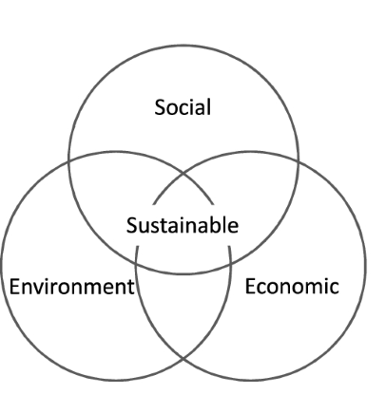
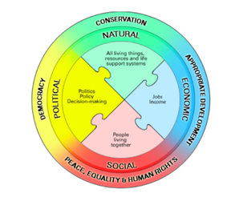
The LEARNING Fin of the Propeller
What are we learning?
The three dimensions of sustainable development (economic, environmental and social) are present to varying degrees in each SDG, however, often missed are the political and cultural dimensions.
Furthermore, we argue the central tenet of the SDGs, requires a level of understanding that goes beyond the enumeration of the dimensions or the identification of the interconnected nature of these dimensions.
What is needed?
Learning about the SDGs, as holistic and integrated in content;
Learning through engaging with the SDGs, as progressive and iterative in processes, and
Learning for sustainability, as transformational of contexts, from the individual, the community, the local, national and global contexts.

Slide 15
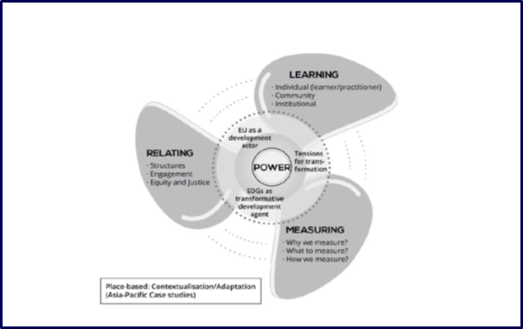


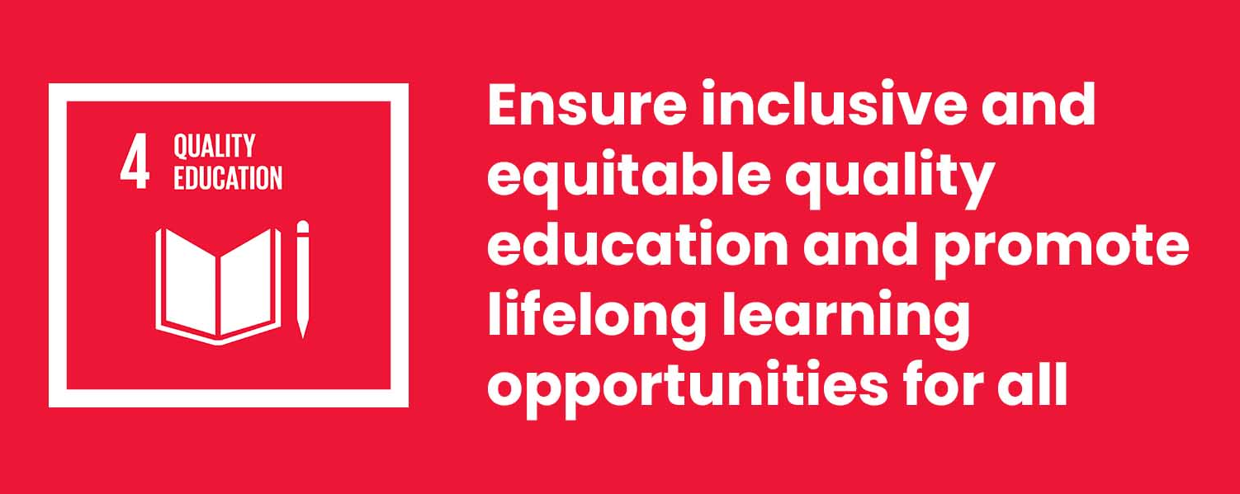
The LEARNING Fin of the Propeller
What are the challenges and opportunities in learning about the SDGs, as holistic and integrated in content?
The story: “What is living or non-living?”
Learning our lessons as advocates: Realisation that knowledge(s) are shaped by the dominant education system. Example is the privileging of formal, scientific and western knowledge by the formal education system. Recognising this has allowed us to better understand why those who decided on the MDGs were focused on Universal Primary Education, and this same narrow focus continues to be prevalent today in the SDGs, despite the success of including lifelong learning.

Slide 16
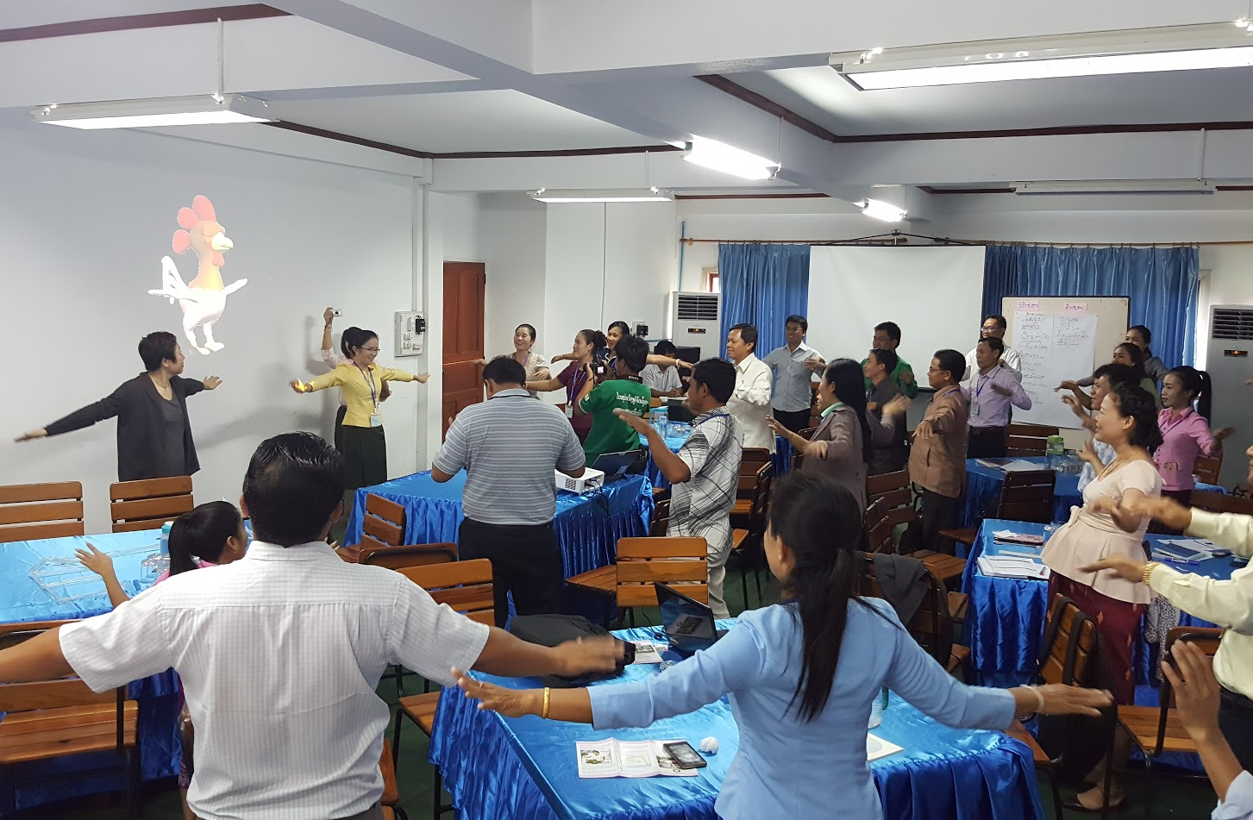
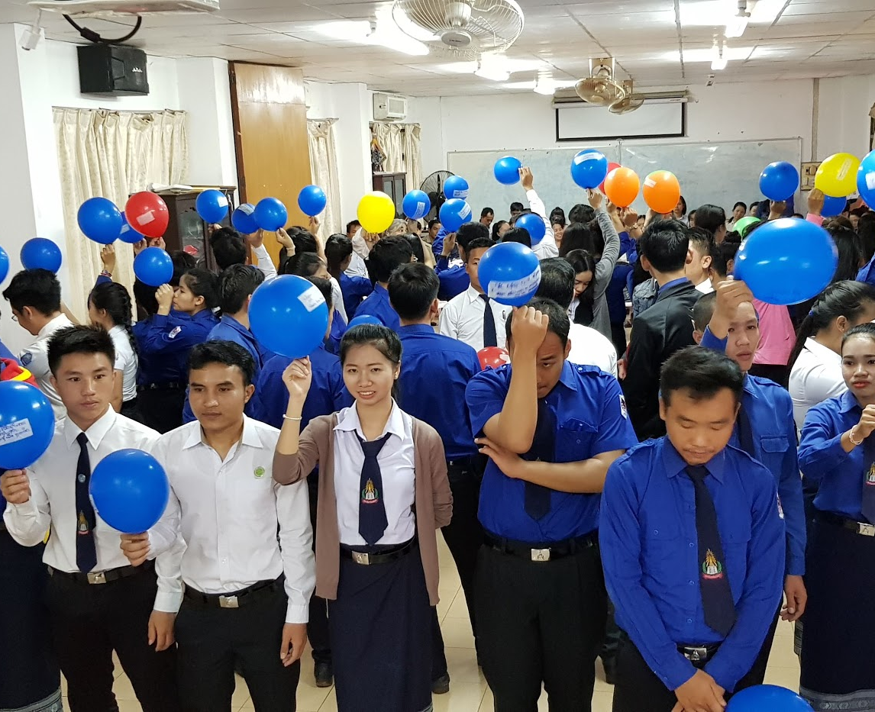

The LEARNING Fin of the Propeller
What are the challenges and opportunities in Learning through engaging with the SDGs, as progressive and iterative in processes?
The story: “Where is the manual?” “You are the manual.”
Learning our lessons through practice: The formal education system had shaped how our participants expected to learn. The Training of Master Trainers (ToMT) in Non-Formal Adult Education wanted to challenge this. It took time but the outcomes went beyond our own expectations. The ToMT didn’t just change our participants, but they themselves contributed to change. For example, the university curriculum for pre-service teachers now introduces the concept of lifelong learning in first year.

Slide 17
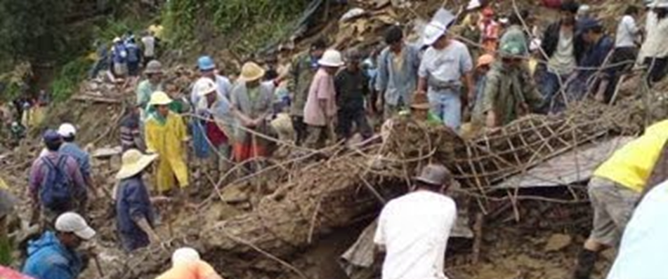
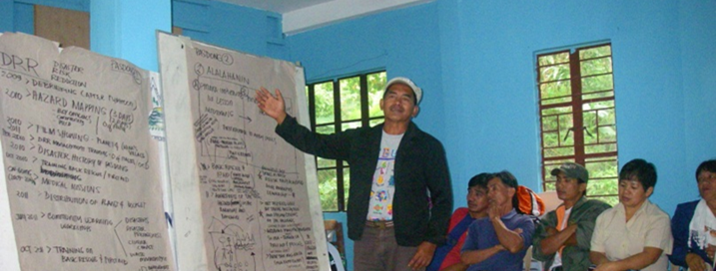
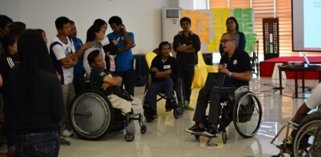
The LEARNING Fin of the Propeller
What are the challenges and opportunities in learning for sustainability, as transformational of contexts, from the individual, the community, the local, national and global contexts?
The story: “Watch the river.”
Learning lessons from practice: Colleagues who worked with this community have taken the learnings on functional literacy and disaster risk reduction (DRR) and have applied it in a different context - advancing the practice of DRR focused on equity and inclusion specifically for people with disabilities.

Slide 18
The MEASURING Fin of the Propeller
Why do we measure?
Measuring, auditing and reporting is often at the end of an activity to report on what has occurred.
Monitoring and evaluation… is iterative, timely and with feedback loops.
SDG targets are measured by indicators – mostly quantitative metrics that emphasize outputs and accountability.
Note: By retaining the same measuring devices that have been used for former development efforts we risk measuring the status quo without learning, reflection and progression.

Slide 19
MEASURING the SDGs
A global indicator framework to review the SDG targets.
231 SDG indicators with 12 indicators repeated under two or three different targets.
These indicators are global measures and intended to complement local, regional and national level indicators.
Assumes:
    each country has relevant, sustainable development policies, plans and programs
    each country has the capacity for measuring against the indicators at all levels (local – national)

Slide 20
The MEASURING Fin of the Propeller
‘The question of what we measure and who does the measuring, how data are collected, interpreted and shared…and how other measures and ways of collecting information are displaced – are contested matters because they are linked with the specific orientation of institutions and policies, the outcomes that they aspire to, and the forms of knowledge that they privilege’
(Mahajan 2019)

Slide 21
The MEASURING Fin of the Propeller
What we measure
Can pose serious social equity challenges.
Cashore (2019) notes ‘there are inherent trade-offs to achieving economic, social and environmental goals where dominant market driven mechanisms prioritise economic goals over social or environmental goals’
Quantitative indicators are reductionist, a tool of neo-liberal and authoritarian governments that can only partly describe social objectives.
State and public sector interests impose systems of measurement to justify and pursue agendas that won’t necessarily lead to transformative outcomes – there are issues of power and disempowerment.

Slide 22
The MEASURING Fin of the Propeller
How are we measuring?
As new development models are embraced, i.e. relational development, traditional methods of measurement need to be revised.
Indicators approximate what the future may look like. To gauge progress measuring will need to establish causal links between intervention and impact.
As impacts are likely to be defined, valued, and experienced differently by people more inclusive approaches to measuring will be required to ensure equitable and sustainable outcomes.
This highlights the importance of place-based learning, relating and measuring.

Slide 23
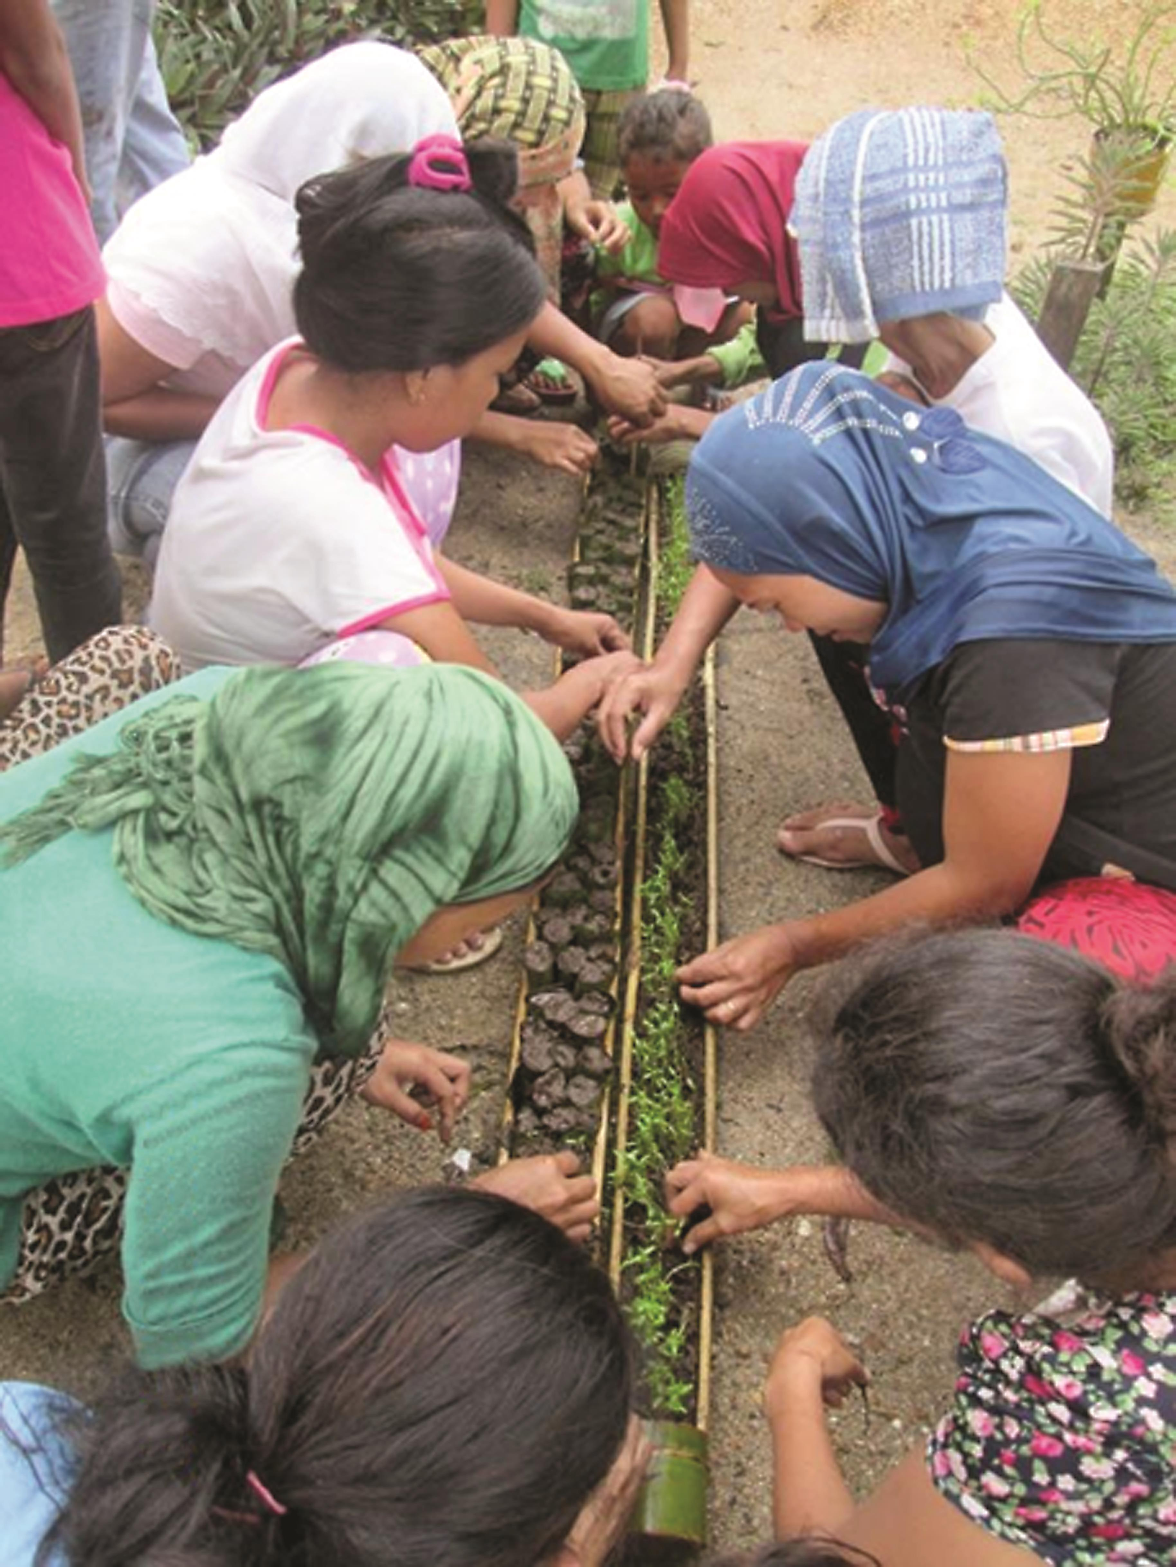
The MEASURING Fin of the Propeller
The Story: Magdaup Vegetable Growers Association, Mindanao

Slide 24
The MEASURING Fin of the Propeller
How are we measuring?
Local decision-making is critical to operationalising the SDGs.
A place-based process provides a mechanism for the required analysis of social, cultural, economic, and environmental conditions and the relationships and interconnections of people and place.
This increases the likelihood of achieving the desired local outcomes toward the SDGs.
The measuring process must be cyclical and participatory. It is only through ongoing review and reflection that learning can take place and people can form ideas and consensus of what is valued.

Slide 25
The MEASURING Fin of the Propeller
Summary
1. A transformative agenda demands an adaptive framework for measuring that can inform and support emergent ideas and answer the question what have we learnt?
2. This shifts the emphasis from outcome driven measuring to the process of measuring i.e. how measuring is undertaken, by whom and for what purpose.
3. Place-based is not only physical and relational but also a space for inquiry and change.
4. Inclusive measuring has potential to empower, enlighten and transform

Slide 26
POWER in the Propeller
Interrogating Power
“…indeed, power is at its most effective when least observable”
(Steven Lukes, 2005:1)
Our conceptualisation of power:
    Is everywhere (dispersed and subject-less).
    Is fluid and relational.
    Is productive – it produces reality.
    Yes, is related to domination, suppression and harm – but this is only part of the story – it also produces good.
    Is not necessarily based on intentionality.

Slide 27
POWER in the Propeller
“We must cease once and for all to describe the effects of power in negative terms: it “excludes”, it “represses”, it “censors”, it “abstracts”, it “masks”, it “conceals”. In fact, power produces; it produces reality; it produces domains of objects and rituals of truth”
(Michel Foucault (1977) Discipline and Punish, p. 194).
The only way to see power is to assume that it is there and ask questions to make it observable.
This can be done via the Propeller’s fins – continual, progressive, iterative and reciprocal relating, learning and measuring…in reflexive and place-based ways.

Slide 28
The Propeller Model

Slide 29
—
Thank you.
Jean Monnet Sustainable Development Goals Network
www.rmit.edu.au/sdgnetwork

