Slide 1

DIGITAL ARCHIVES: ICAM 15
CHRISTINE GARNAUT

Slide 2
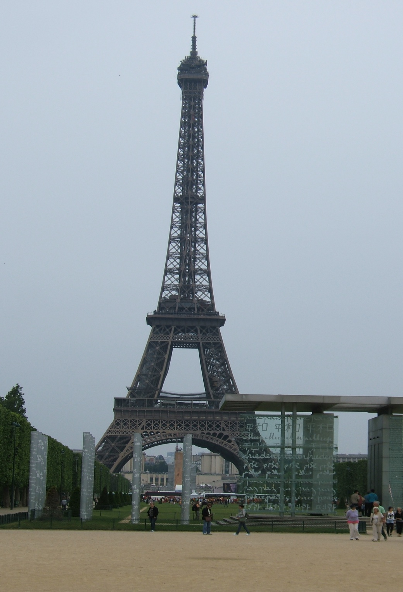
PParis
ICAM
International Confederation of Architectural Museums
http://www.icam-web.org/
*Preserve the architectural record *Raise the quality and protection of the built environment *Foster the study of architectural history in the interest of future practice *Stimulate the public appreciation of architecture *Promote the exchange of information and professional expertise
ICAM 15
Paris
29 May-4 June 2010

Slide 3
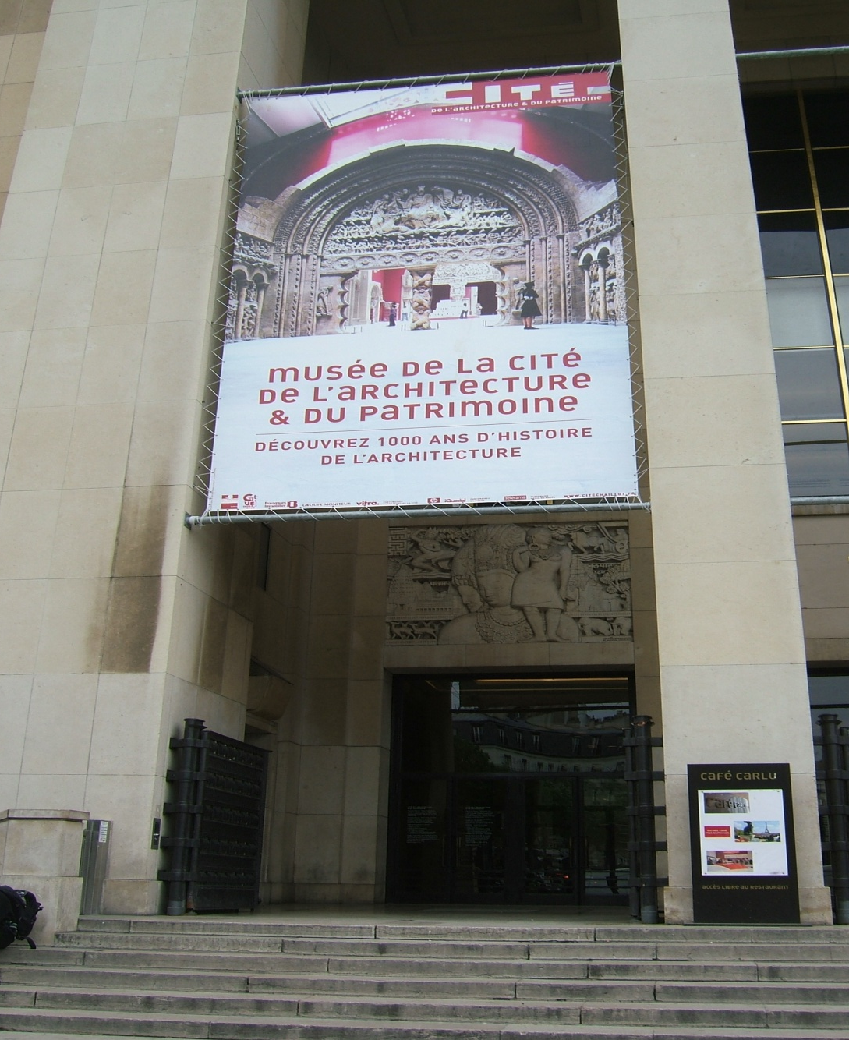

Slide 4
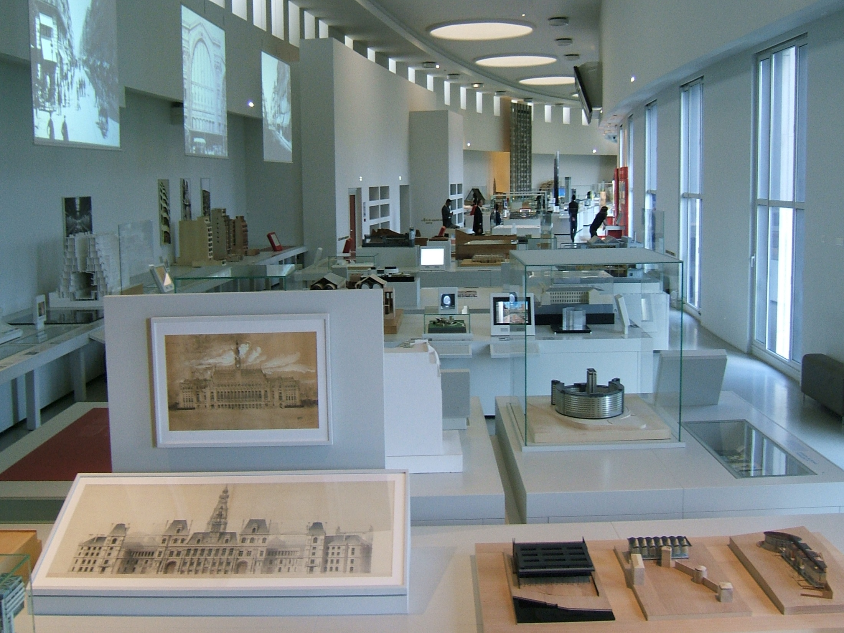

Slide 5
Digital archives: Issues
Subject needs to be addressed but few architectural archives are doing so – lack of leadership/people or place to go for information
Appropriate file format
Platform to read files in the future
Preserving integrity of files
Copyright

Slide 6
Digital Archives: Tips on sources
National Library of Australia
Archiving Conference, the Hague, June 2010
Gau:di Project
MACE

Slide 7
GAU:DI
GAU:DI (Governance, Architecture, Urbanism: a Democratic Interaction) a research programme supported by the European Union under the Culture 2000 Programme
European cultural institutions dedicated to contemporary architecture and its dissemination

Slide 8
GAU:DI
David Peycere (2006) The Gau:di programme: case studies on documents of electronic preservation
PDF available online at: http://www.icamweb.org/data/media/cms_binary/original/1163002339.pdf

Slide 9
MACE
MACE (Metadata for Architectural Contents Europe) a pan-european initiative to interconnect and disseminate digital information about architecture
http://portal.mace-project.eu/

